Slide 1


Review of road design standards and practices.
13 March 2024
United Nations Economic and Social Commission for Asia and the Pacific
Paul Disney
Highways, Traffic, and Road Safety Consultant- EASST
Find us
@EASSTransport

Slide 2

13 March 2024
Project aims and objectives:
To review CAREC road design standards and practices,
to identify how road safety might be improved.
My contribution concentrates on technical issues
(rather than institutional responsibilities).
This short presentation summarises my approach.

Slide 3
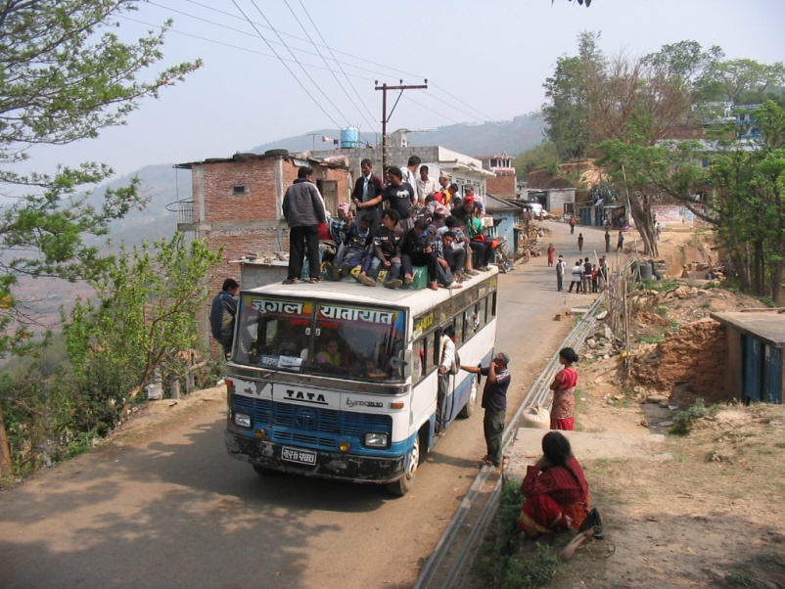
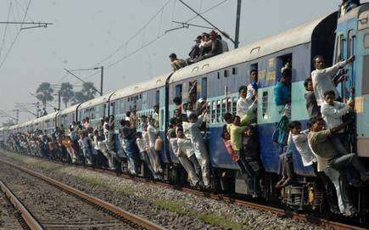

13 March 2024
How to maximise safety is a fundamental and essential consideration for everyone involved in all modes of travel :

Slide 4
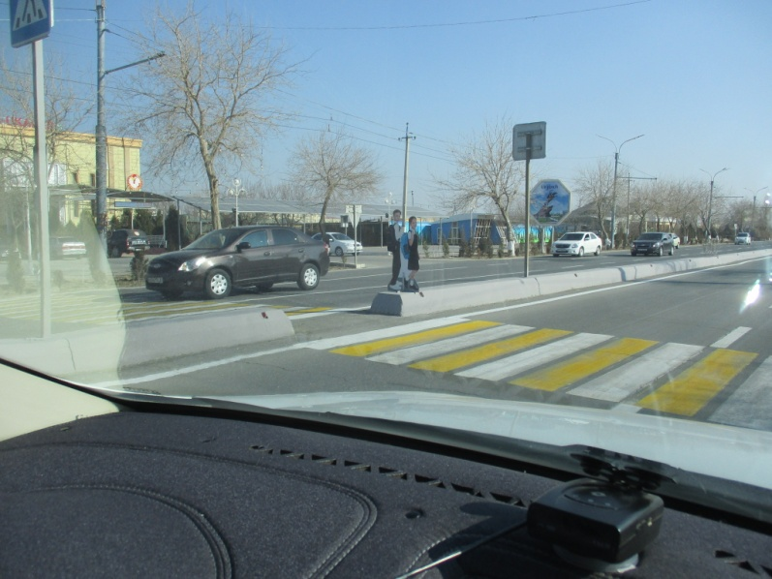
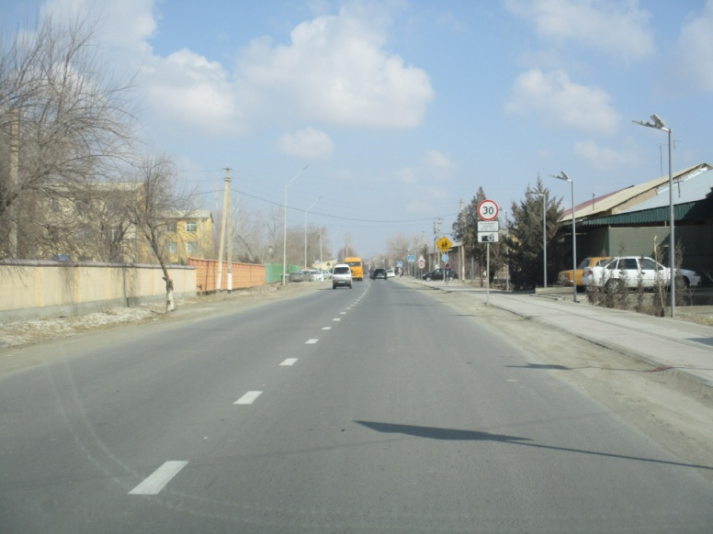
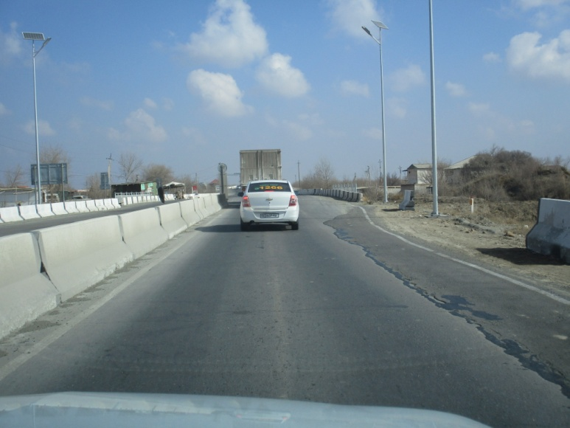
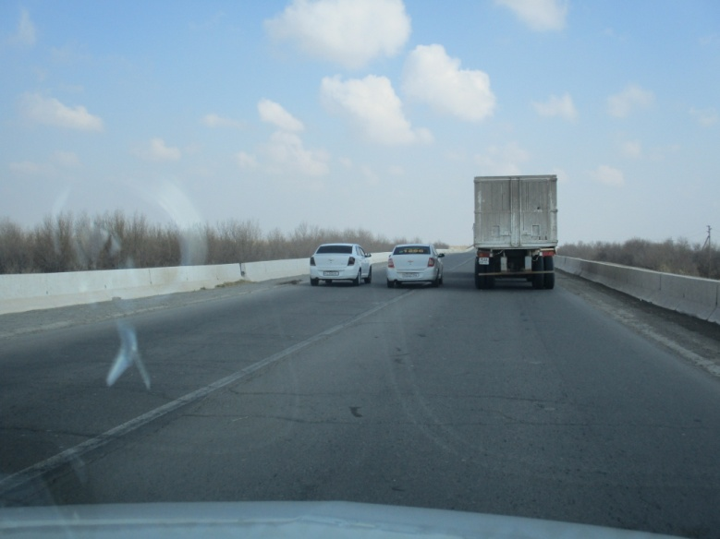
13 March 2024
We all want the same thing: No fatalities or injuries.
The question is how to progress towards/achieve that aim.

Slide 5
13 March 2024
There are five important topic areas to improve road safety :
Road infrastructure engineering
Vehicle design engineering.
Road users as people:: Education, road user skills. children, elderly, disabilities, driver training, licensing.
Laws and enforcement–on+off street, Courts, insurance
Emergency services, speed and effectiveness of response to crashes; subsequent medical treatment.

Slide 6
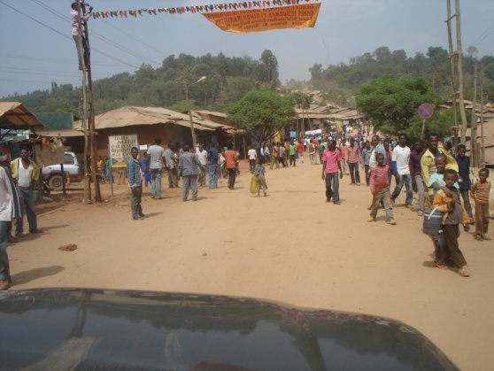
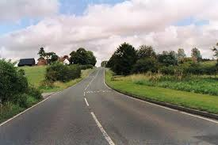
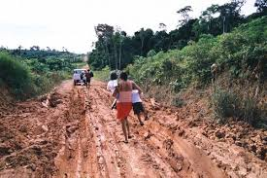
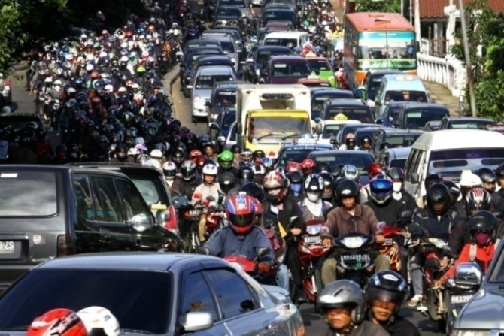
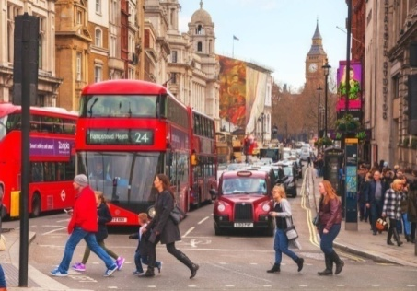
13 March 2024
Road infrastructure engineering

Slide 7
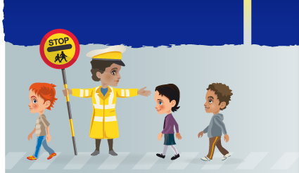
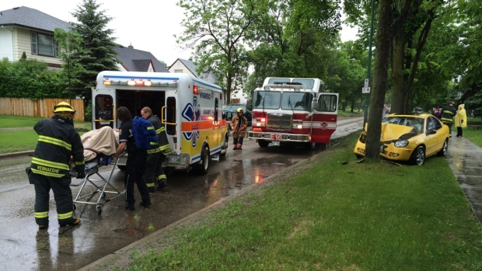
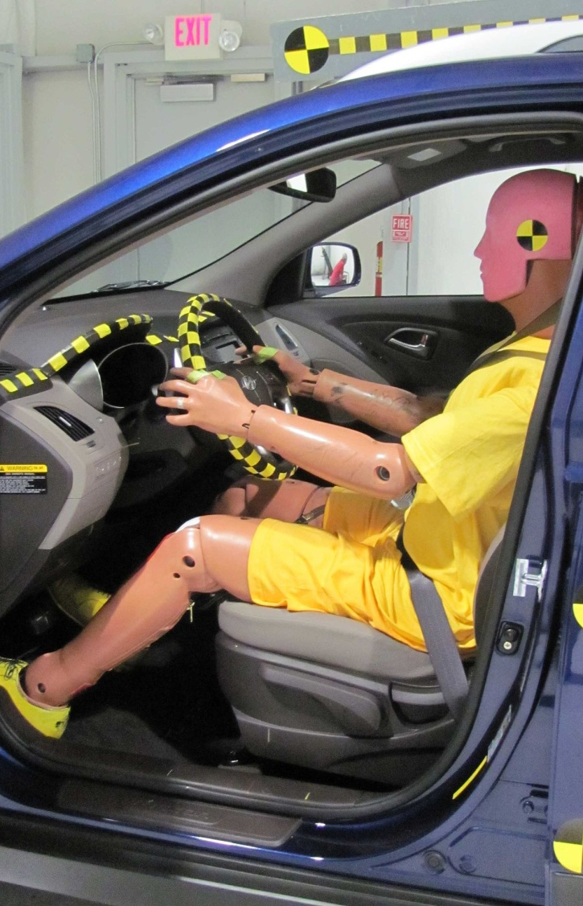

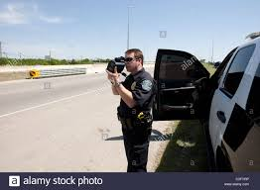
13 March 2024
Vehicle design, road users as people, laws and enforcement
emergency services :

Slide 8

13 March 2024
Our project is concerned with the first –
Road infrastructure engineering and design standards.
But all five areas are inter-related.
And the Traffic Police are fundamentally important to our review, because they pick up the pieces on-road, of the consequences of design choices. Sometimes literally bodies.

Slide 9
13 March 2024
Assessment of road infrastructure engineering safety divides into:
1. Existing roads
2. Proposed designs of new road projects, large or small

Slide 10
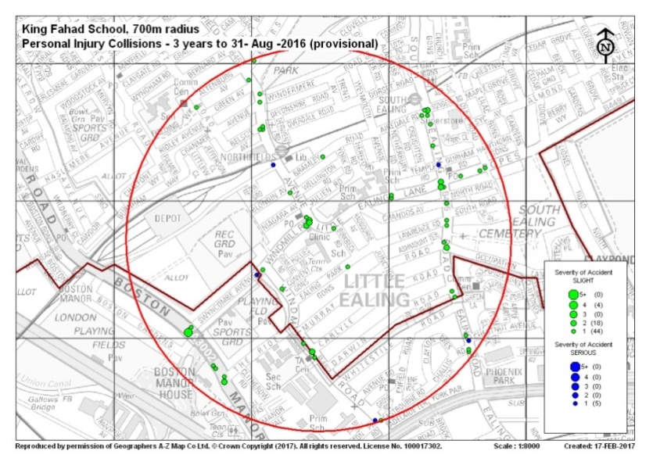
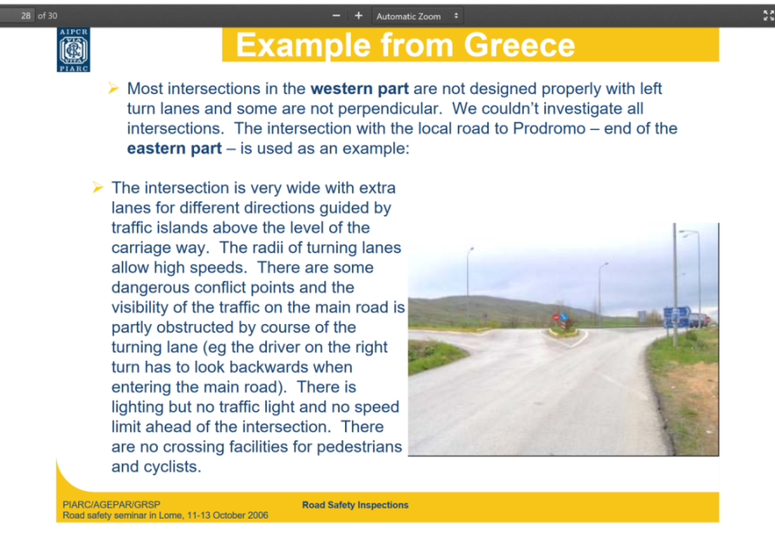
13 March 2024
Existing roads are assessed traditionally by black spot crash data analysis
Also by Road Safety Inspection (RSI), practical on-site assessment to identify hazardous conditions. RSI does not check compliance with design standards; RSI looks for risks.

Slide 11
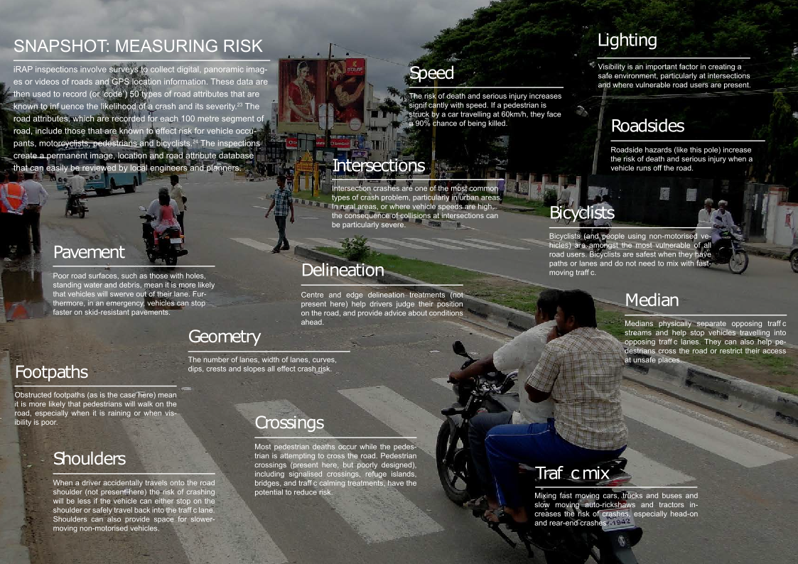
13 March 2024
iRAP is a computerised database technique for RSI, which compiles a valuable inventory of road characteristics important for road safety and presents analyses.

Slide 12
13 March 2024
Proposed designs are assessed:
- by Road Safety Audit (RSA)
- by Road Safety Impact Assessment (RSIA),
RSIA is valuable at the Feasibility stage, but not widely used or well understood.
(EU2008/96 Road infrastructure safety management and amended by EU2019/1936 provides detailed definitions)

Slide 13
13 March 2024
Road transport projects develop through a process of:
Project identification
Feasibility Study assessment, including Design Standards
Preliminary and Final Design proposals
Construction Contract
Operational opening of the road
Management, maintenance, and rehabilitation

Slide 14
Existing roads or new road designs
Existing Feasibility Draft Detailed Construct Post- Post-
Road Study Design Design Construct Opening
-RSIA->
Impact
Assessment
------------------------------------------ RSA ------------ - - - - - - - - - - - - - - - - ->
Audit
------------ RSI ------------> - - - - - - - - - - - - - - - ->
Inspection
-Crash analysis-> - - - - - ->
------------- RS review -------------------------> - - - - - ->
Road safety assessment techniques.
When should each technique be used?

Slide 15
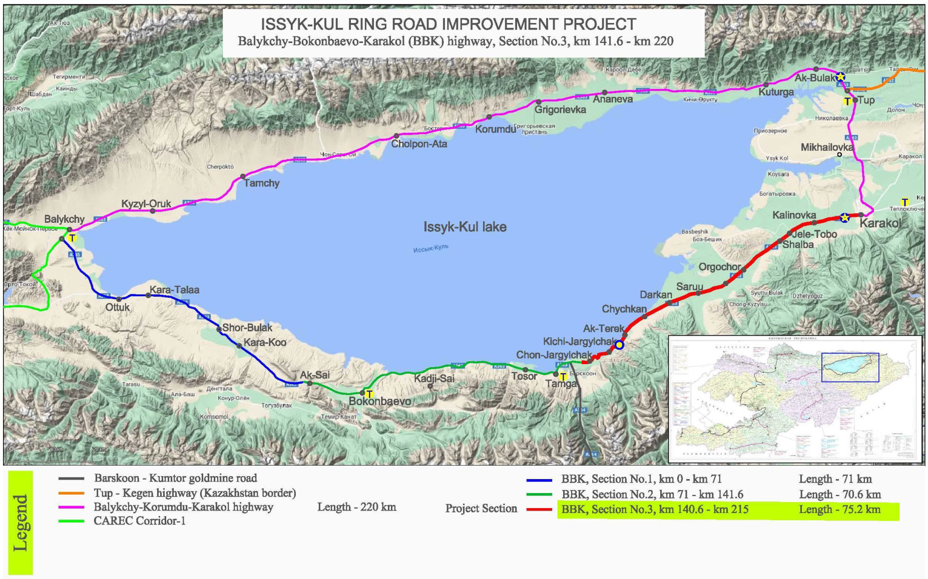
13 March 2024
Design standards are established during the Feasibility Study and used at this stage to estimate project costs.
These Design Standards – established and agreed in the Feasibility Study - are then applied without question to preparation of the Preliminary and Final Designs.
Last year I was asked to prepare an RSA of a Final Design for Lake Issyk-Kul Ring Rd, financed by Asian Development Bank

Slide 16
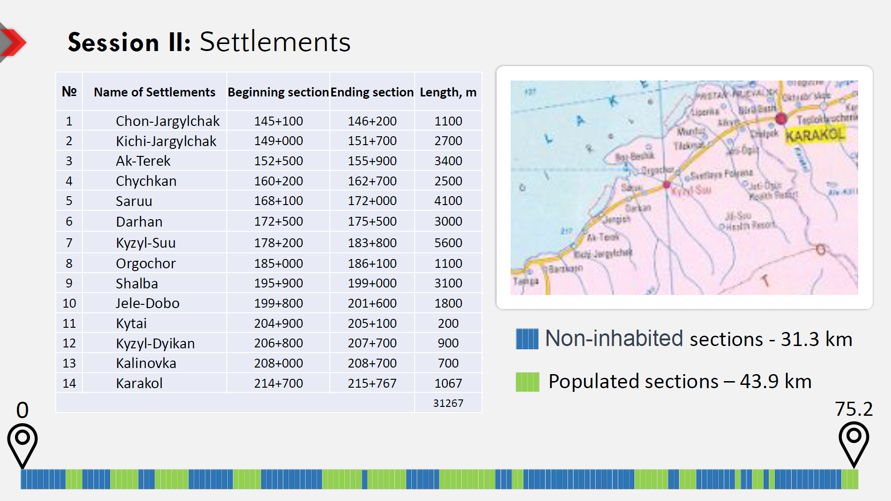

Slide 17
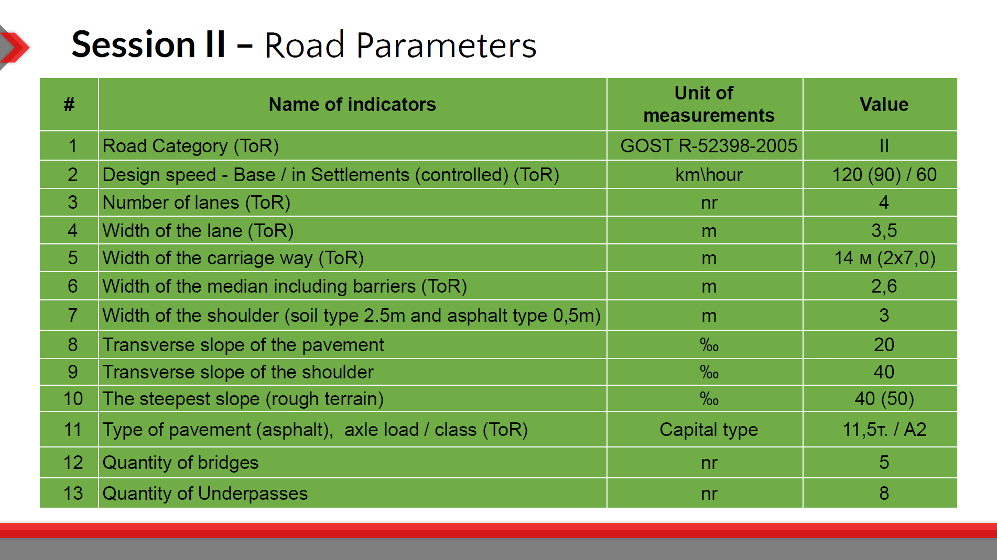

Slide 18
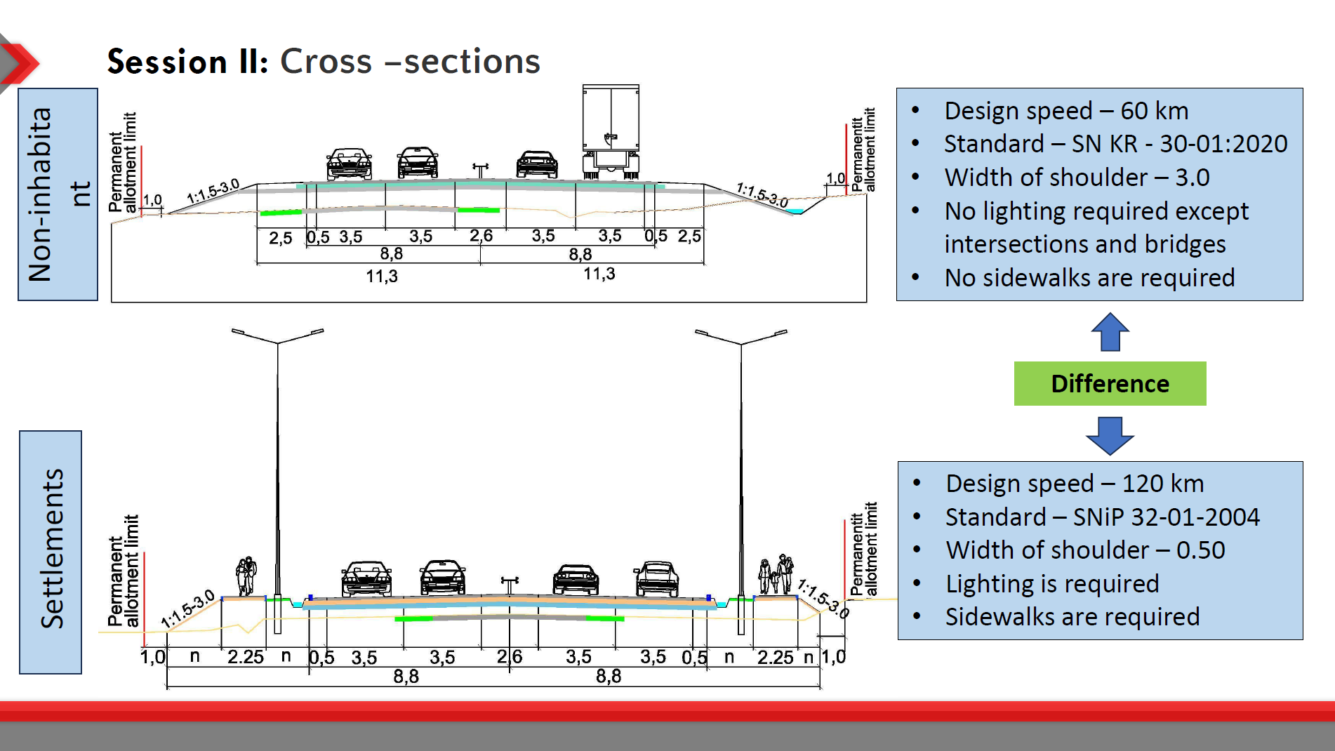

Slide 19
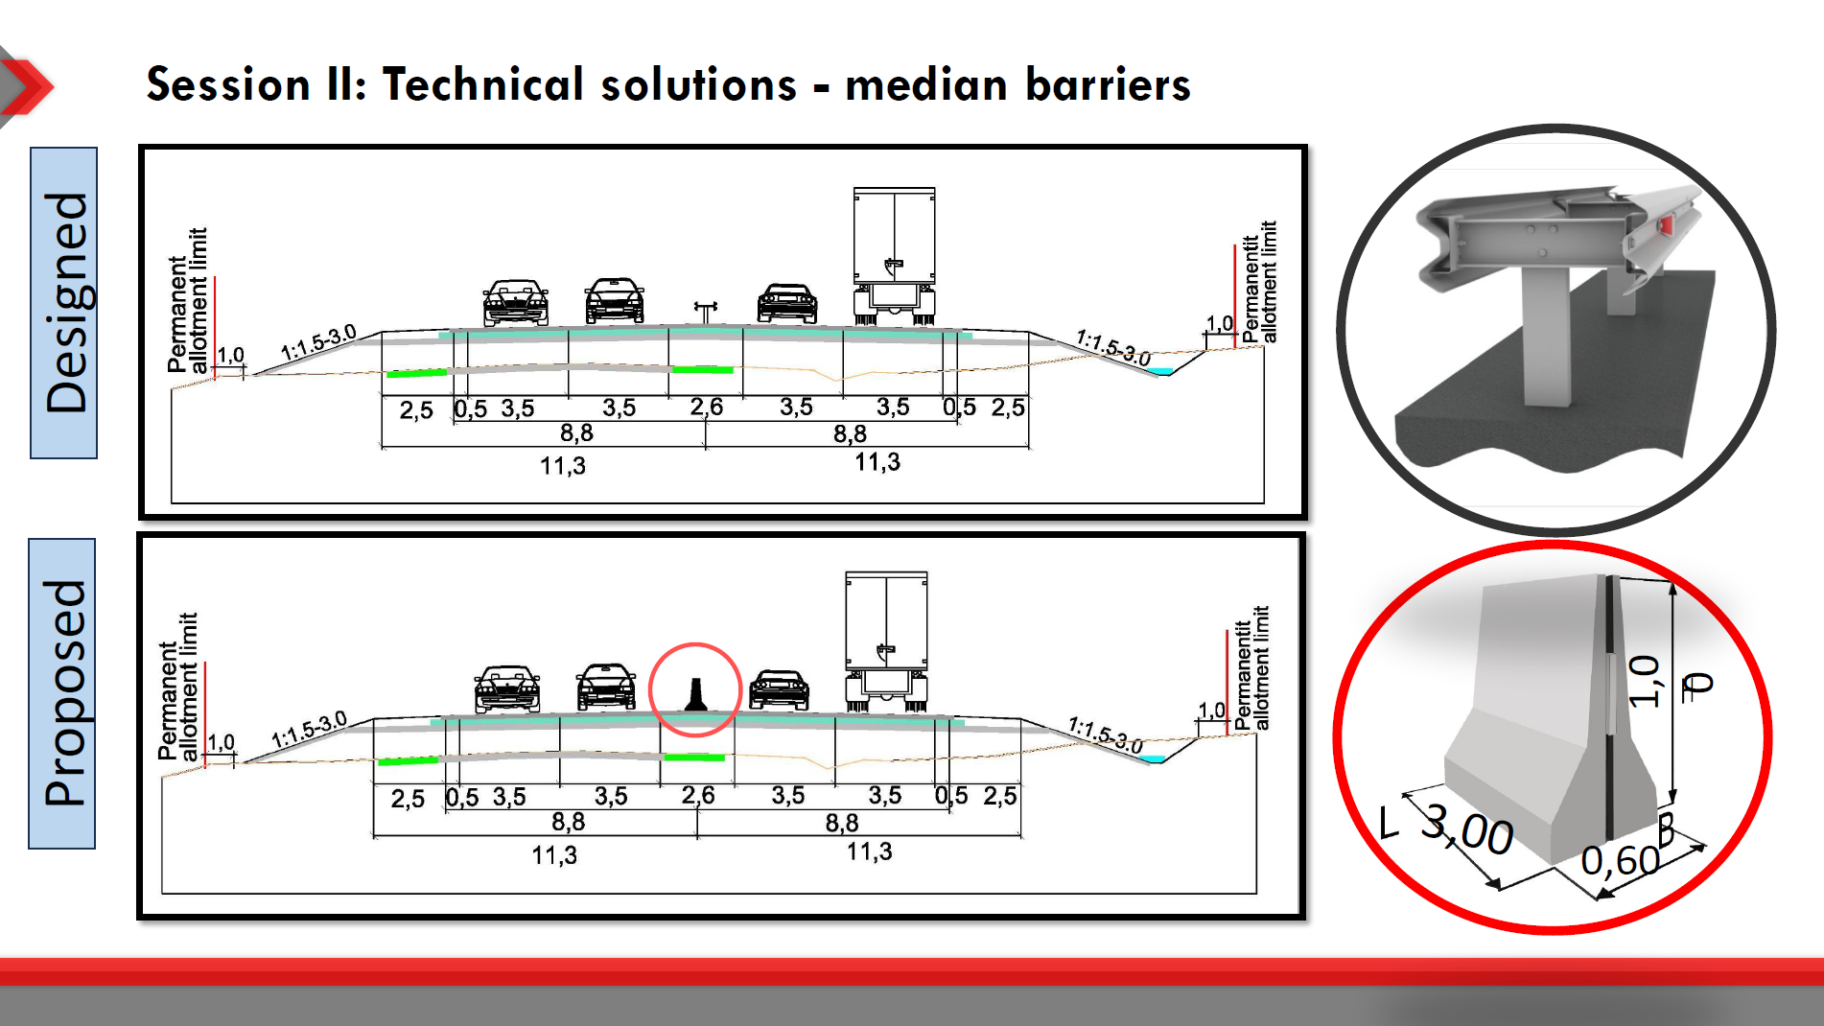

Slide 20
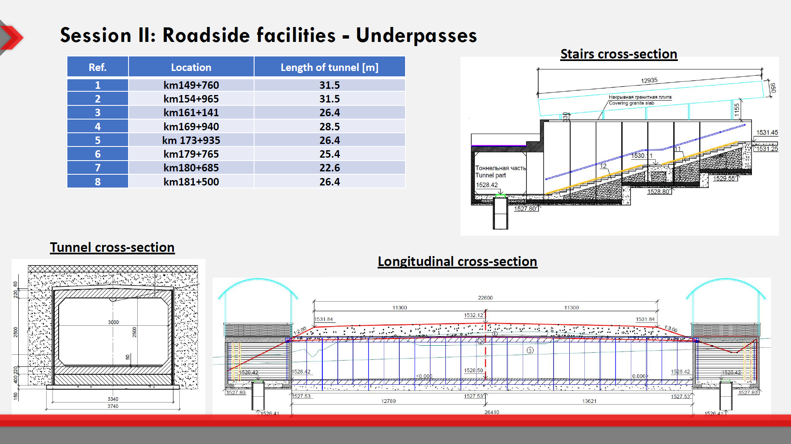

Slide 21
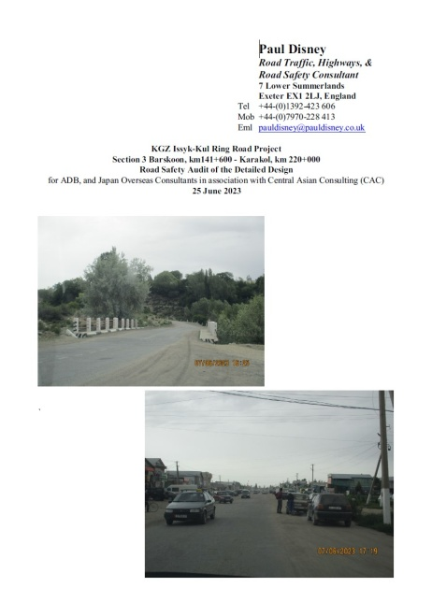
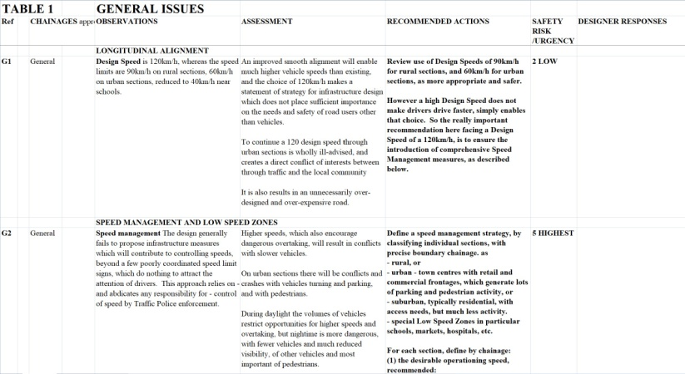
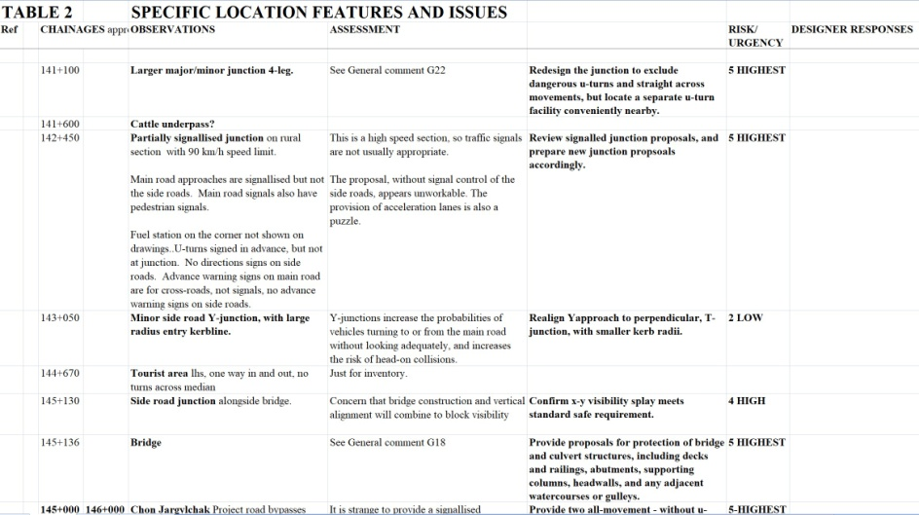
13 March 2024
How road safety audit and inspection can make highway engineering designs safer
My RSA Audit Recommendations were:
General Report, including summary of crash data, and discussions with the local Traffic Police,
Tables with General and location-specific Recommendations.

Slide 22
13 March 2024
My Recommendations were sub-divided into improvements
Speed and overtaking management: longitudinal alignment and speed calming features.
On-road cross-sections: median, lanes, shoulders
Roadside safety: edge protection, crash barriers, embankment side slope, Clear Zones and off-road danger
Intersection designs: major/minor, provision of u-turns, signalisation, roundabout, (no project grade separation)
Accessibility and facilities for all road users, pedestrians, children, elderly, disabled, cyclists, small karts, public transport
Serious problem of animals in the roadway
Road signs and markings

Slide 23
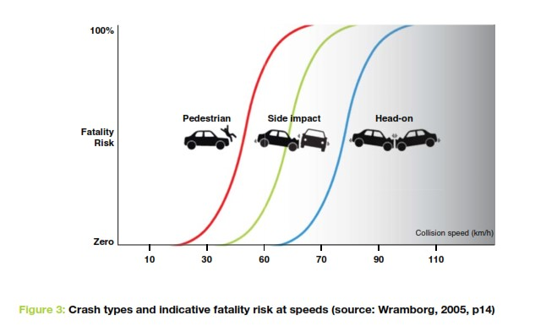
13 March 2024
Speed and overtaking management strategy
Speed management is fundamental to road safety.

Slide 24
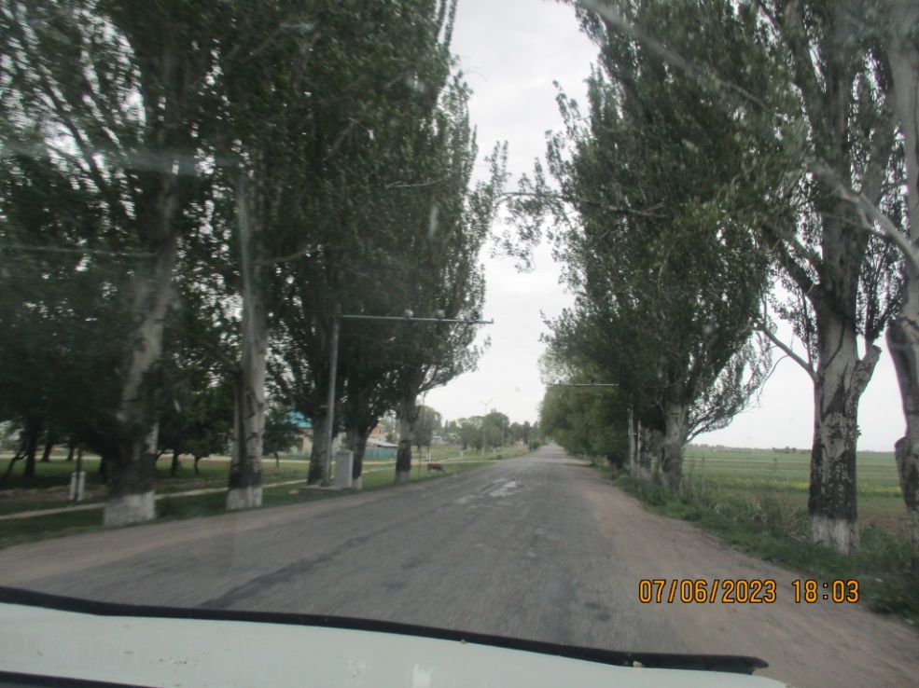
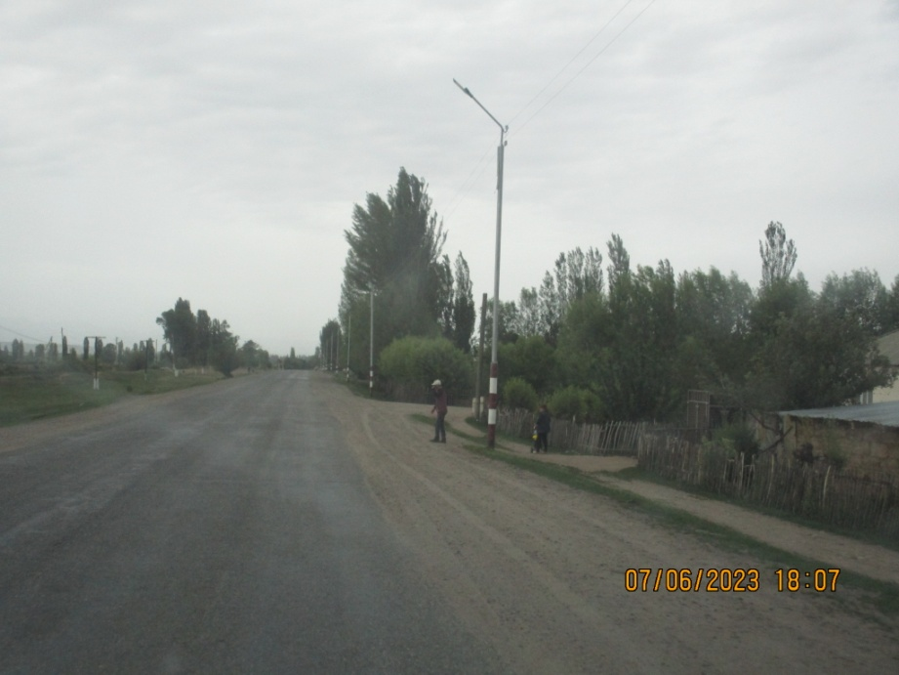
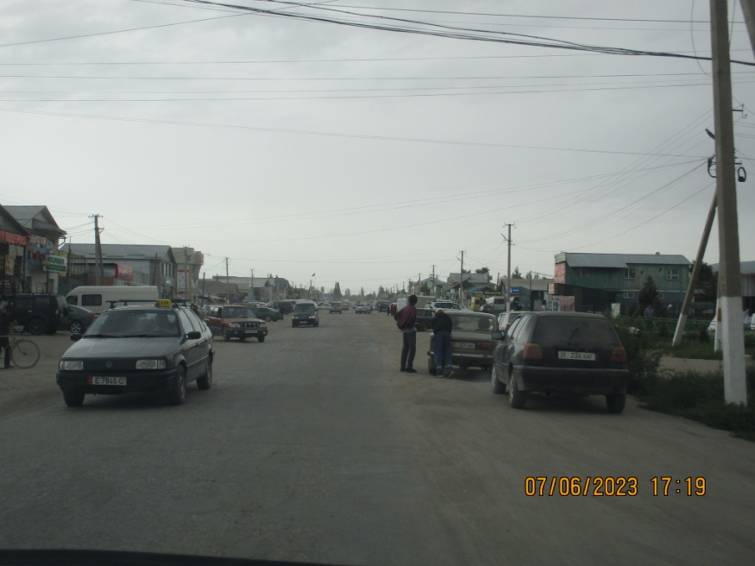
Speed and overtaking management strategy
Divide the entire length of the project according to the type of frontage development, into “rural”, “suburban”, or “urban” sections, with precise chainages.
Define sub-sections for special design attention: major intersections, schools, markets, hospitals, etc
Define the desirable operating speed for each section.
Define the consequent speed limit, and design speed.

Slide 25
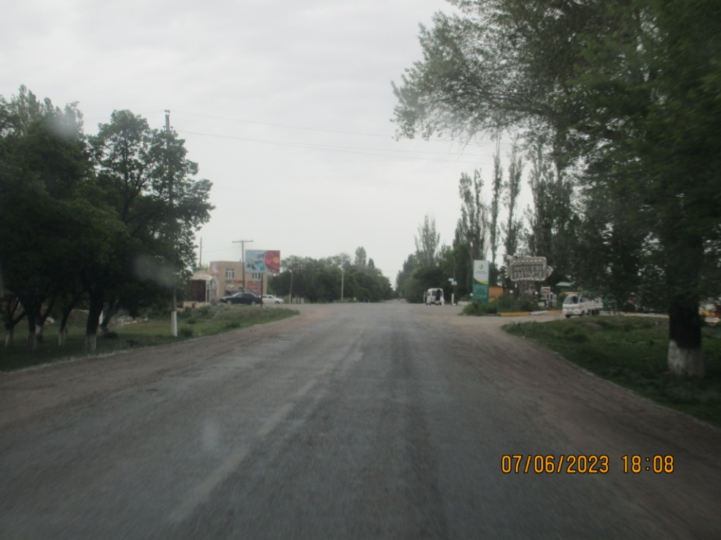
13 March 2024
Speed and overtaking management strategy
rural, 90km/h – except for sub-standard sections.
special attention to control speeds and overtaking at major intersections.

Slide 26
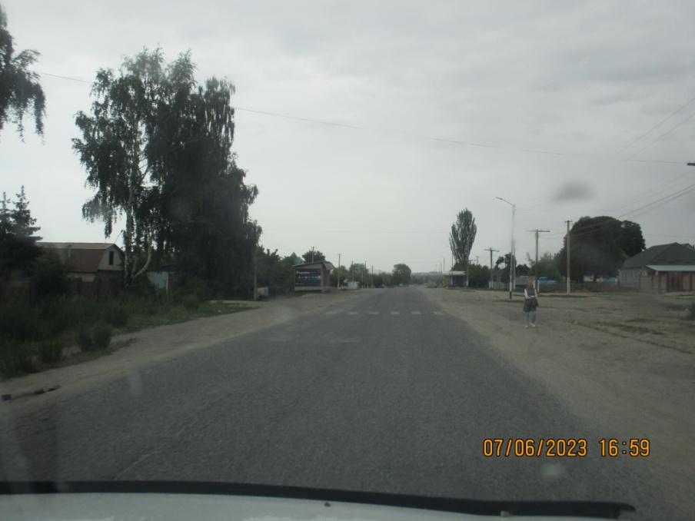
13 March 2024
Speed and overtaking management strategy
suburban, 60 km/h, typically residential, with access needs, but much less activity.
classify village bypasses as suburban, usually 1 or 2 junctions with village access roads, also pedestrians and bus stops.

Slide 27
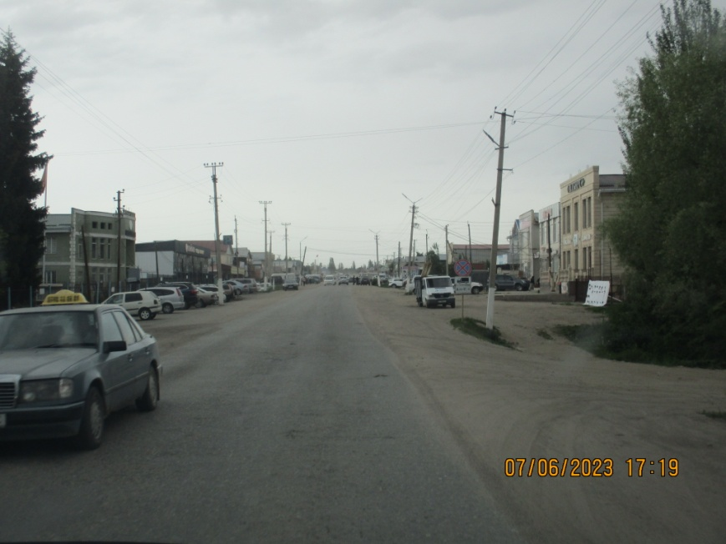
Speed and overtaking management strategy
urban and special Low Speed Zones , 40 km/h or 30km/h:
town centres with retail and business frontages, lots of parking and pedestrian activity.
special attention to LSZs for schools, markets, hospitals, etc.

Slide 28
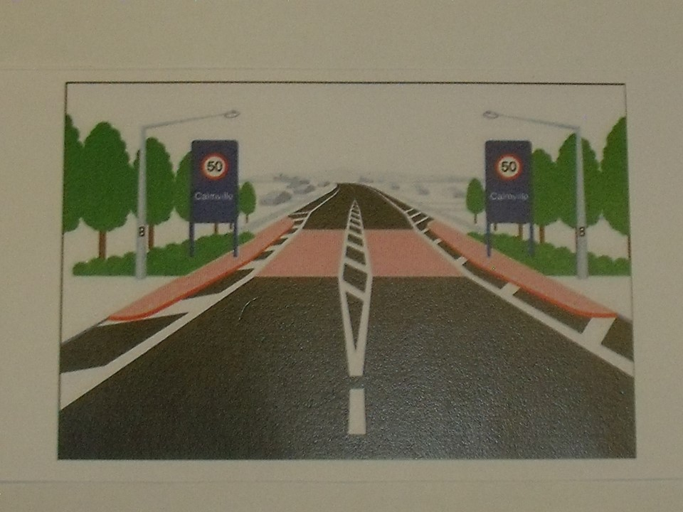
13 March 2024
Speed and overtaking management strategy
Introduce simple boundary gateway features between sections with different operating speeds.
To increase driver awareness, coordinate cross-section changes, from rural to suburban to urban shoulders, footways, drainage

Slide 29
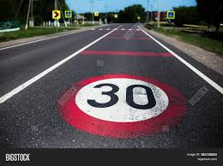
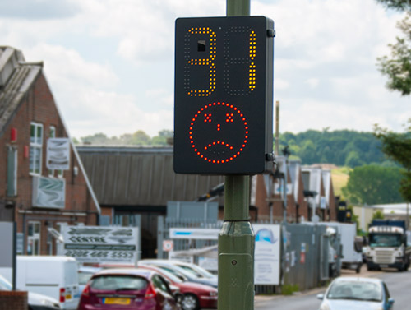
Speed and overtaking management strategy
Provide repeat speed limit signs as signs, and/or large painted signs on the road surface.
And possibly as interactive signs, which flash when a vehicle is going too fast.

Slide 30
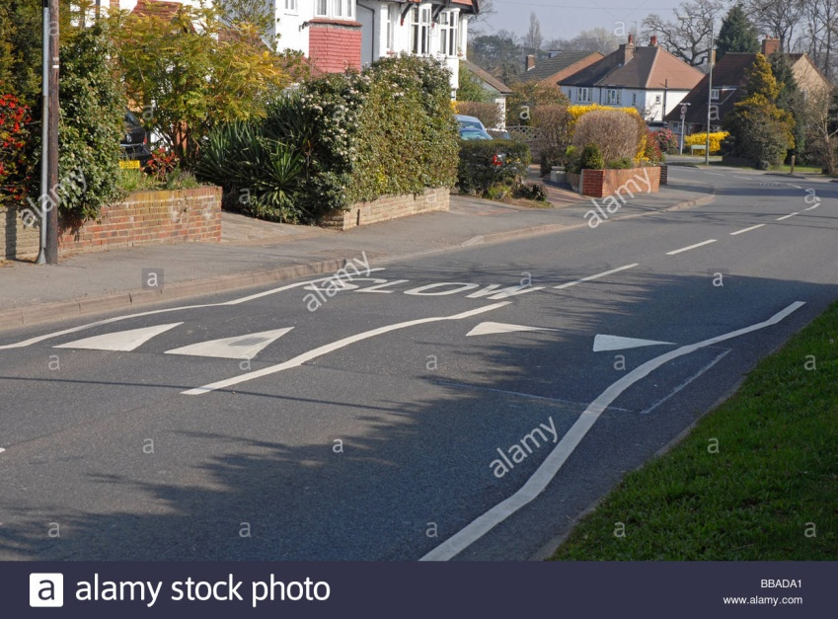
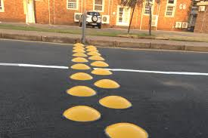
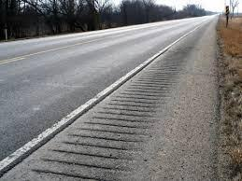
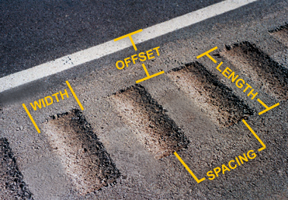
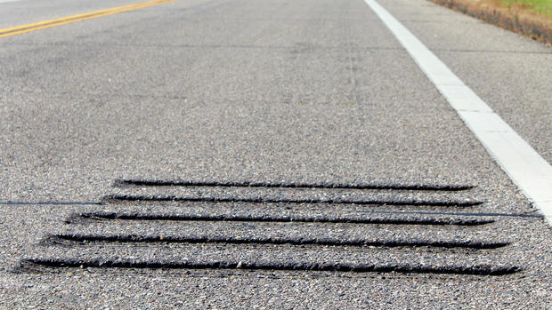
Speed and overtaking management strategy
Introduce rumble strips and/or speed humps.

Slide 31
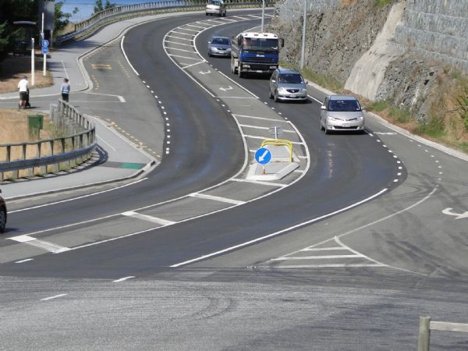
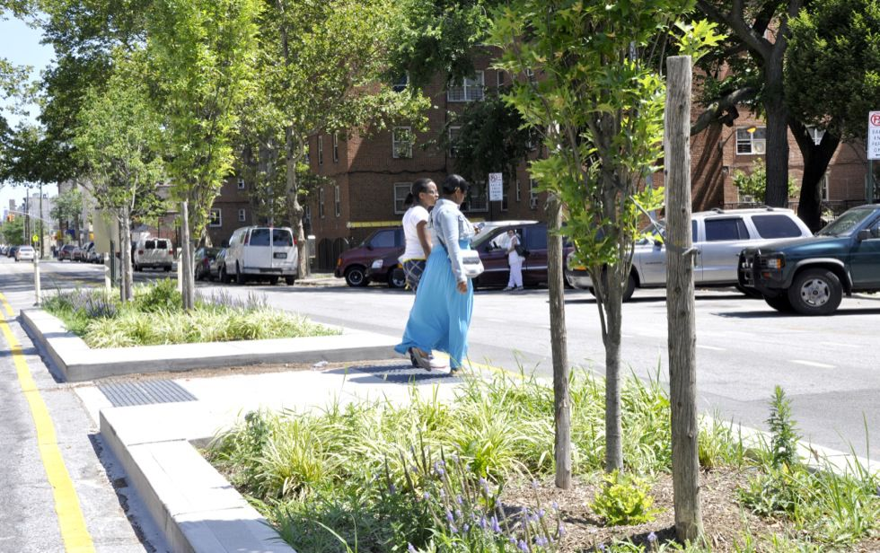
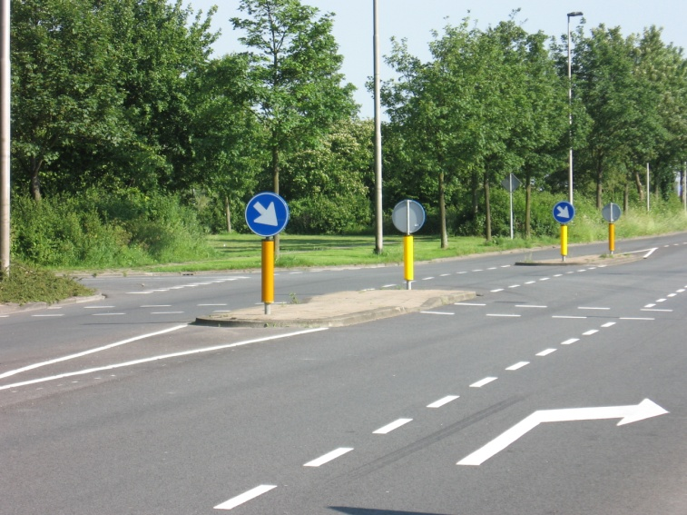
13 March 2024
Provide pedestrian refuge central islands
with raised kerbs, but no zebra markings

Slide 32
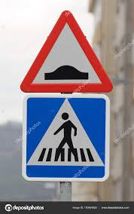
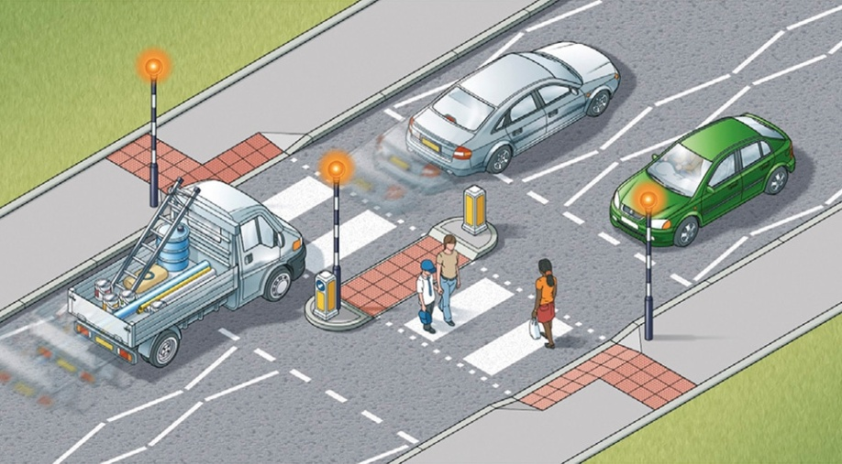
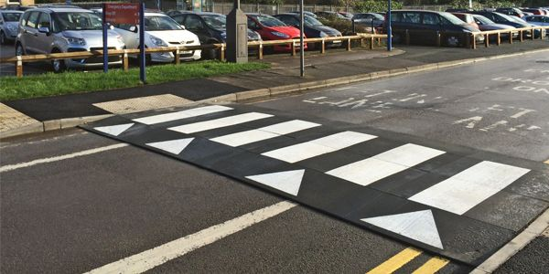
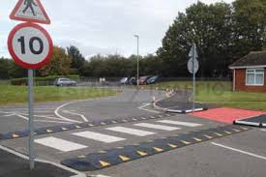
13 March 2024
combined with speed humps,
self-enforcing (reduced Traffic Police speed checks)popular with most people (except speeding drivers)
Speed and overtaking management strategy
Provide pedestrian (zebra) crossings

Slide 33
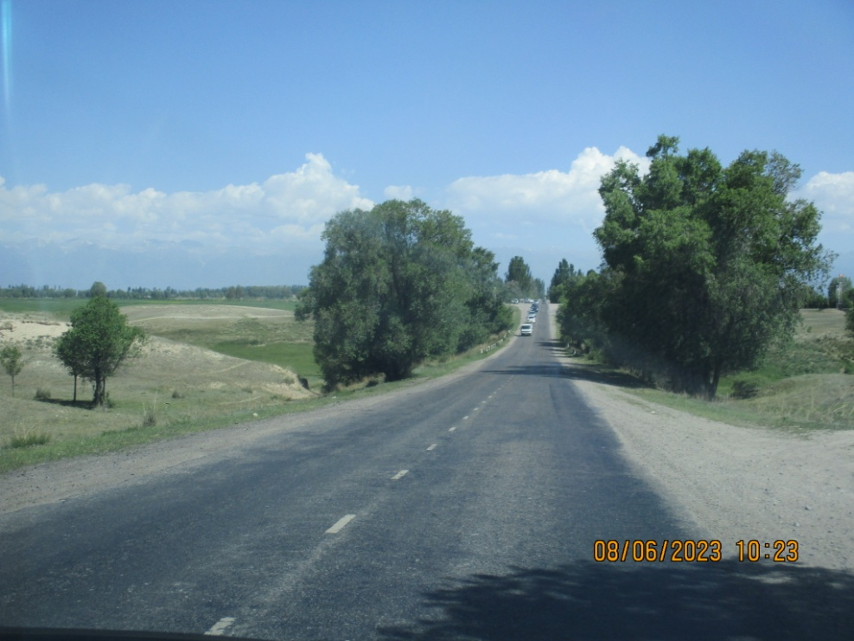

Road Safety Design Decisions
Choice of embankment side slope, and how 1:1.5 directly causes fatalities and serious injuries – ignored by designers?
Criteria for where to provide crash barriers
Choice of drainage ditch profiles
Have Clear Zone criteria been applied? eg trees, utility poles, street lighting poles)

Slide 34


Road Safety Design Decisions
Design engineers must try to make Clear Zones more “forgiving”, by:
Identifying roadside hazards,
Giving drivers the chance to retain control of steering and speed, and avoid impacts; by, in order:
Eliminating the hazard, or
Moving the hazard, or
Modifying the hazard to make it more “forgiving”, or
Shielding the hazard with crash barriers - the last option.

Slide 35

Intersection designs, and u-turns
Proposed rural simple major/minor t-junction
central barrier creates need to manage diverted vehicle u-turns
lack of median width for u-turns
high-speed straight through movements in same lane as slow turning vehicles
on this proposal, provision of zebra crossing on 90km/h section

Slide 36

13 March 2024
Accessibility problems, junction design, and u-turns
Rural – proposed larger major/minor X-junction
removes high-speed through movement from turning lane
but lack of median width for safe u-turns
adds crossroad straight-across movement to all other movements
fails to provide any safety for pedestrians or bus stops

Slide 37

13 March 2024
Intersection designs, and u-turns
Proposed simple u-turn arrangement
same lack of median width for u-turns, which creates a dangerous path for turning vehicles of any size.
Visualise a large truck turning, or agricultural tractor and trailer.

Slide 38

13 March 2024
Intersection designs, and u-turns
Rural – proposed signallisation
90km/h approaches
no traffic signals provided for side roads
signs and markings not appropriate

Slide 39
13 March 2024
Intersection designs, and u-turns
Urban - proposed major/minor junctions and parking
Comprehensive review required of design, for 40km/h speed limit, pedestrians, bus stops, freight deliveries, car parking, side road junctions and accessibility

Slide 40

13 March 2024
Accessibility problems, junction design, and u-turns
Urban - proposed signallisation

Slide 41
13 March 2024
How road safety audit and inspection can make highway engineering designs safer
In addition, other ever-recurring issues:
Crash protection of bridges and culverts, for the structure, against vehicles falling into watercourses, and also for pedestrians from vehicle impacts.
Proposals for underpasses.
Ensuring long-life road paint, and reflectivity of traffic signs
Lack of speed de-restriction signs – so nobody knows where a low speed zone ends?
Where to provide street lighting.
Frangible columns, in particular for street lights, but also for major road signs, and other rigid obstructions
Construction TTM.

Slide 42
13 March 2024
So at this moment in the project:
Final Design and Contract Documents are finished and agreed, and proposed to ADB for financing
But the Road Safety Audit has identified a lengthy list of Recommendations, most of which require only minor variations to the Final Design,
but would require the designers to spend money and time to change the Design and Contract Documents.
Project experience shows, project after project, that RSA Recommendations are often not even responded to, and when they are, they are dismissed, “buried”, ignored, then conveniently forgotten.

Slide 43
13 March 2024
And this “Review of CAREC road design standards and practices” seeks to ensure that road design for road safety is included in the project process from the Beginning, ie the Feasibility stage.

Slide 44
Review of CAREC road design standards and practices
We all want the same thing: No fatalities or injuries.
The question is how to progress towards/achieve that aim.

Slide 45
13 March 2024
Thank you!
Paul Disney
Highways, Traffic, and Road Safety Consultant
Find us
@EASSTransport

