Slide 1
Rural Roads Management
Tyrone Toole
Sustainable Infrastructure Management Group

Slide 2
The context
Access conditions
  diverse range reflecting natural regions and level of development
Required outcomes
  safe, reliable and efficient access for communities (and road users)
  minimising the long term costs of initial provision, operation, maintenance, and renewal
The Challenge
  optimising the utilisation of available financial and human resources
  sustainability
Solutions – many exist, so let’s harness and adapt
Notes:
Management of risks
financial risks
operational risks
prioritisation
‘Must do’
‘Should do’
‘Could do’
Examples
Victorian Road Management Act
WA Treasury maintenance planning guidelines
Indonesian Road Traffic Law
Management of risks
financial risks
operational risks
prioritisation
‘Must do’
‘Should do’
‘Could do’
Examples
Victorian Road Management Act
WA Treasury maintenance planning guidelines
Indonesian Road Traffic Law

Slide 3
Scope & Objectives
Planning and management of rural road infrastructure
  Promote efficient use of available, usually constrained funds, to have a greater impact.
  Demonstrate examples of effective investment in knowledge generation, dissemination and training in rural road management
  Deliver sustainable solutions

Slide 4
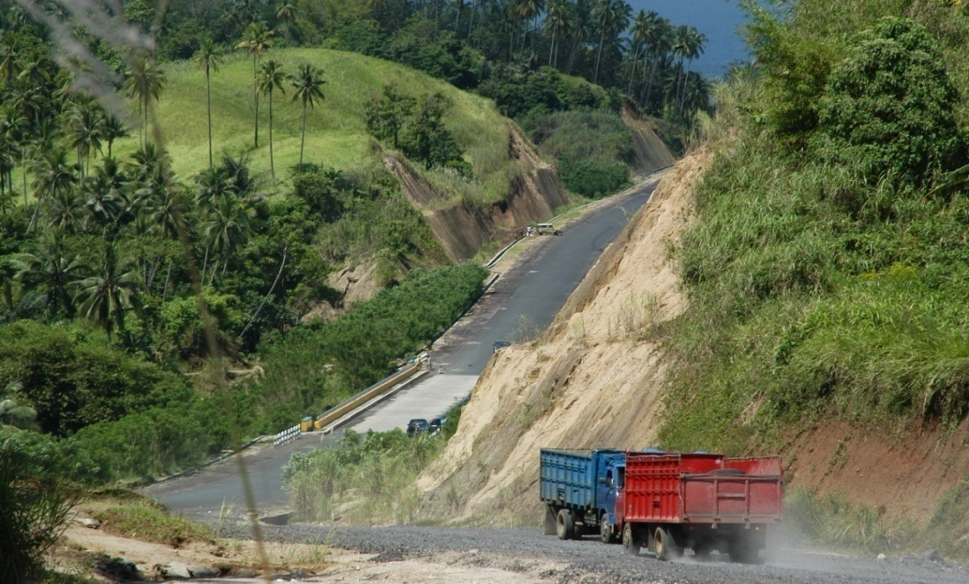
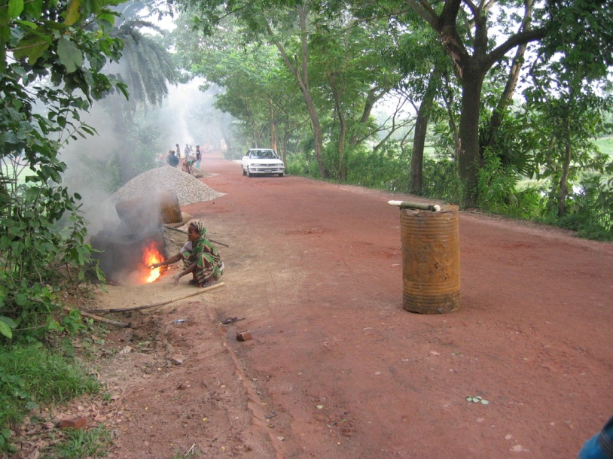
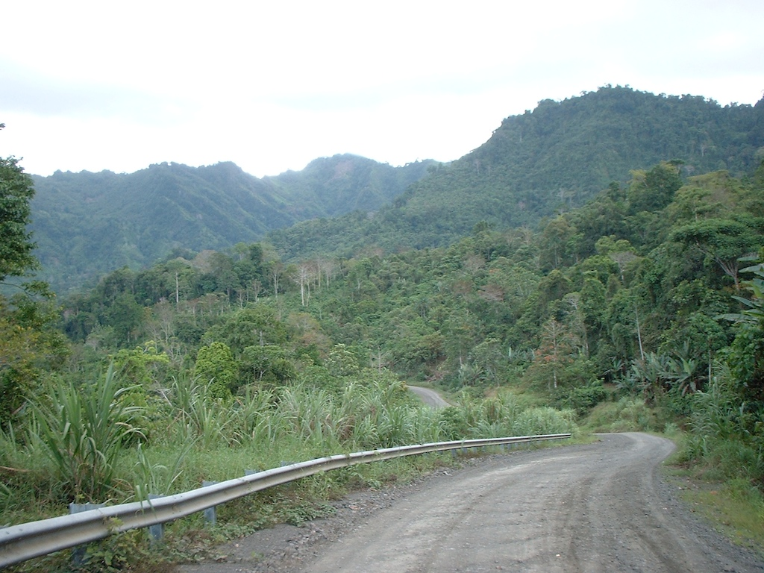
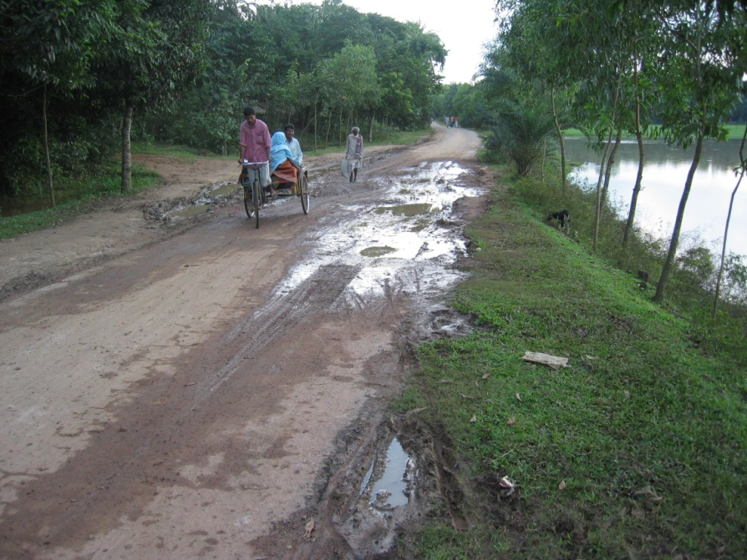
The circumstances….
Notes:
The circumstances in which we work and are very varied, and our strategies and solutions must be adapted to meet these.
These are of course familiar to us all.
Returning to Road Asset Management, let us review what it is about
NEXT SLIDE

Slide 5
What has changed?
Increased recognition of the importance of an effective network for –
  delivering community benefits
  as an engine for growth
Realisation of the disbenefits of a lack of action, leading to –
  increased transport costs
  losses in asset value

Slide 6
What are we trying to deliver?
…………..community benefits………….
……..desirable levels of service at minimum cost………..
………… public expectations………………
……….cost effective decisions, with economic trade-offs……
Notes:
Alternative definitions exist, so let’s see what is common.
They emphasise …………………
Common threads exist, and most imply benefits of some kind, or a stated LOS at least cost
Only one (in its ultra short form) seems open-ended, i.e. meeting public expectation, but at what cost.
Getting more specific…………
NEXT ZSLIDE

Slide 7
Onwards to..
Total
Transport System Management
(to meet demand/priority outcomes)
Environment
Building communities
Integrated system
Regional development
Mobility
Preservation &
renewal of
existing assets
+++
Accessibility
Economic
Safety
Notes:
In at least one definition, AM involves the preservation and renewal of existing assets.
However, the key is to understand and aim to satisfy DEMAND (including policy directives) with a suite of solutions drawn from road use management, asset preservation and renewal, and capital investment strategies.
The outcomes, and associated benefits we aim to achieve are many.
This is a substantial challenge, but a greater awareness of our purpose and the planning and implementation of appropriate actions should improve our chances of meeting the needs of the community.
Whilst there is a need to focus, there is also a need to guard against ‘silo mentalities’ and seek solutions which provide transport services at least cost to the community in an integrated manner.
NEXT SLIDE

Slide 8
Integrated AM Phases
Strategic planning process
Actions
Evaluation
Phase 1
Define
objectives
Phase 2
Form
strategies
Phase 3
Develop
program
Phase 4
Identify
needs
Phase 5
Implement
program
Phase 6
Audit
work
Phase 7
Review
Review
Feedback
Notes:
Setting objectives by understanding customer needs
Formulating asset strategies
Developing investment program, including service levels
Preparing explicit plans, taking account of funding scenarios in terms of resources and consequences
Ensuring effective implementation
Reviewing performance outcomes and update processes and procedures

Slide 9
Phase 1: Example Objectives & AM KPI’s
Build effective access to services
Reduction in crashes & cost of road trauma
Assist economic & regional development
Develop a more integrated & sustainable road transport system
Minimise impacts on the community & the environment
Road condition - % network meeting target access levels
Achievement of specified STANDARDS
Achievement of agreed treatment programs
Implementation of ‘best practice’
Customer satisfaction
Notes:
All Authorities have Objectives, including KRA’s and KPI’s, to provide focus for Asset Management. Let’s look at a few examples and consider them.

Slide 10
1. What condition should State roads be in?
4. What level of funding would be required to address findings?
Performance criteria & condition
Data issues
Program management
Project selection
Outcomes
Engagement
Accessibility
Safety
Efficiency
Retained value
2. What is the actual condition of State Roads?
3. What is being done to address any gap?
Road surface, Geometry, Bridges & Structures
Notes:
They start with a set of Q’s
The scope is identified
They consider specific outcome areas
For the first 2 Q’s performance criteria are essential to assess condition, and data is key
On the right, the emphasis is on how information is used and decisions taken, and to what extent stakeholder needs are considered
Some of the earlier findings drew on such a study structure
NEXT SLIDE

Slide 11
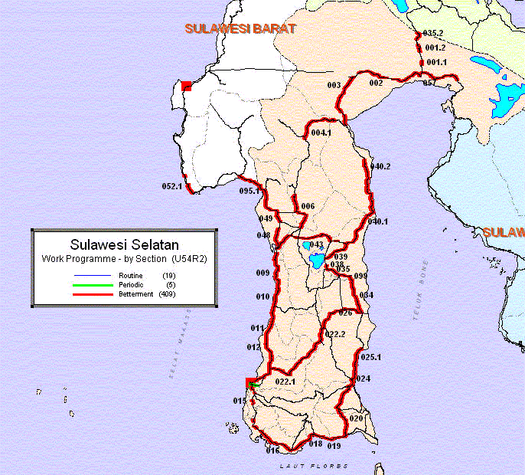
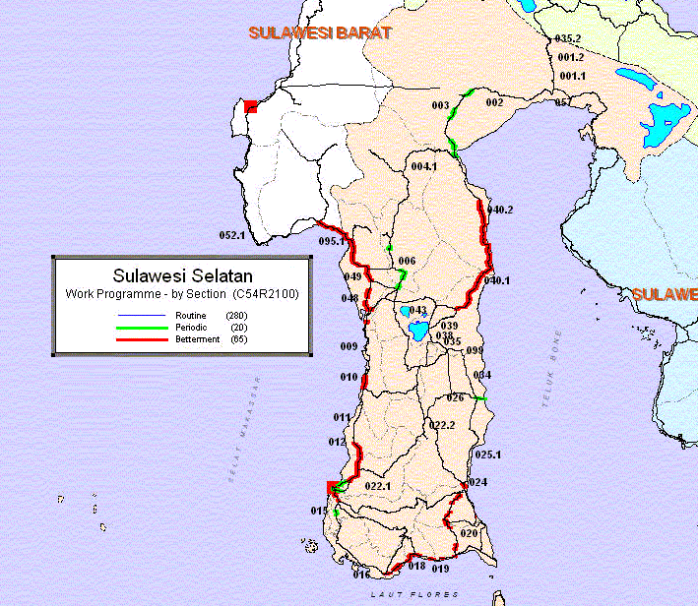
Are our budgets sufficient?
Are our standards appropriate?
What are the consequences on the network?
Have we sold the benefits/outcomes to users?
Unconstrained – desirable standards
Constrained
Notes:
Getting specific, we can quantify the ideal, but life is not so easy
Whether it is south Sulawesi, as shown here, or nearer home, as shown yesterday, all is not well.
We saw examples yesterday where current funding was grossly inadequate, and severely constrained delivery of benefits. As the findings suggest, this is not uncommon.
What would JOE PUBLIC say if he knew
Surely inadequate funding only builds a backlog.
Such circumstances raise more questions, such –
Are our standards appropriate, and are we crying wolf, or not
What are the consequences of achieving, or not achieving
Have we sold the benefits of our proposals to the users
Let’s take a common analogy
NEXT SLIDE

Slide 12
Maintenance Considerations
Effective and timely maintenance crucial to safety, efficiency and retained value
Fundamental need to emphasise:
  The importance of Maintenance & Preservation
  Obligations of the ‘Owner’
  The role and scope of Asset Management
Maintenance should be:
  a regular process not a random event
  preventative, not reactive
  responsive to repair defects within a prescribed time frame
Notes:
As stated, Maintenance, including routine, periodic and rehabilitation maintenance activities form a range of activities which are deployed to best meet network needs.
In Australia this normally involves a substantial investment in preventative work to minimise future degradation, and costly interventions.
In addition to basic routine maintenance which must comply with specified standards, periodic surfacing treatments are key, and follow the Stitch in Time philosophy (see next slide).
This approaches allows surfacings to last in excess of 10 years, often more than 20 years, and for the life of a rehabilitation treatment to be well in excess of 40 years. In Victoria, the average pavement life is 65 years.
This approaches delivers very high benefits, at reasonably low cost, whilst new work, or work deferred to when pavement renewal is necessary, is always marginal.
(Next Slide)

Slide 13
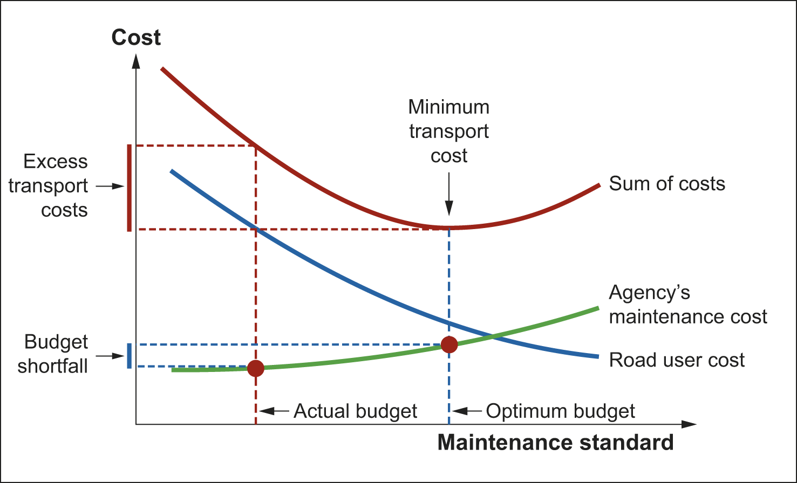
Consequences of not acting

Slide 14
Cost Effectiveness against Standard of Road
95% of year, access established
99% of year, access established
Marginal productivity
Maintenance for roughness reduction
0
Maintenance expenditure $/km

Slide 15
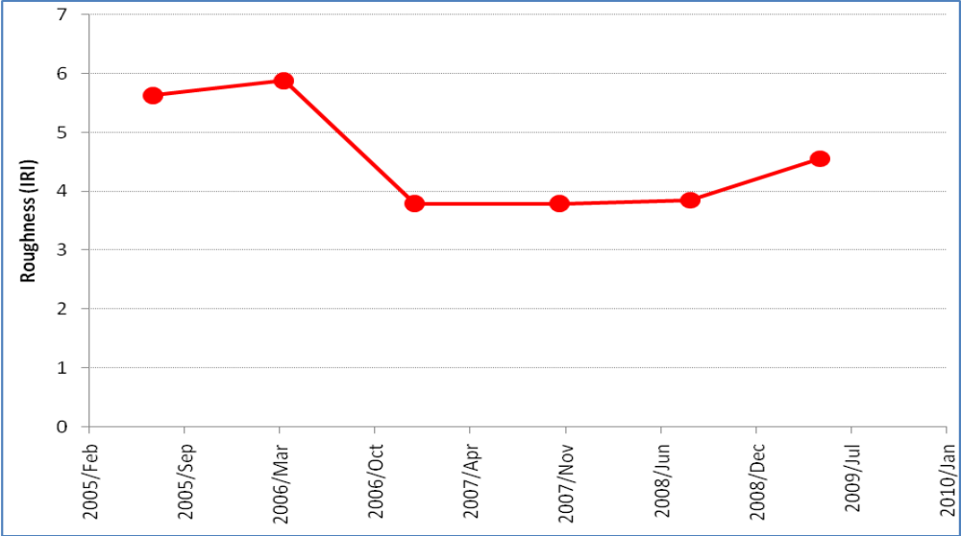
A simple case of the effectiveness of routine maintenance
Slow response
Fast response
Notes:
As stated, Maintenance, including routine, periodic and rehabilitation maintenance activities form a range of activities which are deployed to best meet network needs.
In Australia this normally involves a substantial investment in preventative work to minimise future degradation, and costly interventions.
In addition to basic routine maintenance which must comply with specified standards, periodic surfacing treatments are key, and follow the Stitch in Time philosophy (see next slide).
This approaches allows surfacings to last in excess of 10 years, often more than 20 years, and for the life of a rehabilitation treatment to be well in excess of 40 years. In Victoria, the average pavement life is 65 years.
This approaches delivers very high benefits, at reasonably low cost, whilst new work, or work deferred to when pavement renewal is necessary, is always marginal.
(Next Slide)

Slide 16
Typical benefits: Developing country examples
Measures Typical Benefits
Access restoration (unsealed)
EIRR > 20% at 50 vpd
EIRR > 100% at 200 vpd
Optimum maintenance (unsealed)
EIRR > 50% at 25 vpd
EIRR > 100% at 50 vpd
Optimum maintenance (sealed)
EIRR 20% - 40% at 500 vpd
EIRR 30% - 70% at 1,500 vpd
Province wide periodic maintenance and rehabilitation program
EIRR > 40%
Economic warrants for upgrading
from 50 – 100 vpd and above
EIRR – Economic Internal Rate of Return
Notes:
Let’s look at some benefits from real Australian studies
Any surprises
Does it help confirm hunches
Does Granny’s adage…..’A stitch in time….’ ring true

Slide 17
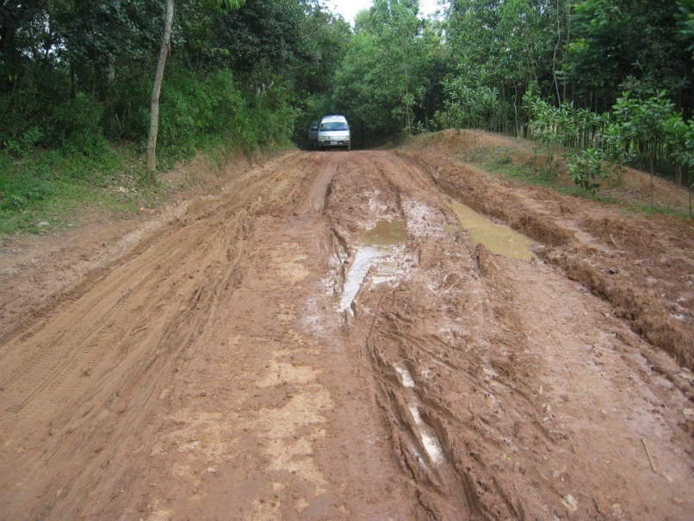
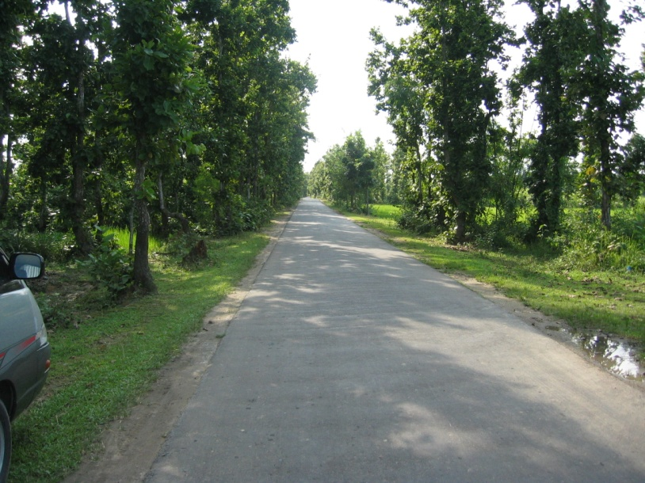
Practices: What should be done?
Needs’ analysis
Identification of risks
  financial risks
  operational risks
Prioritisation
  ‘Must do’
  ‘Should do’
  ‘Could do’
Detailed treatment selection and design

Slide 18
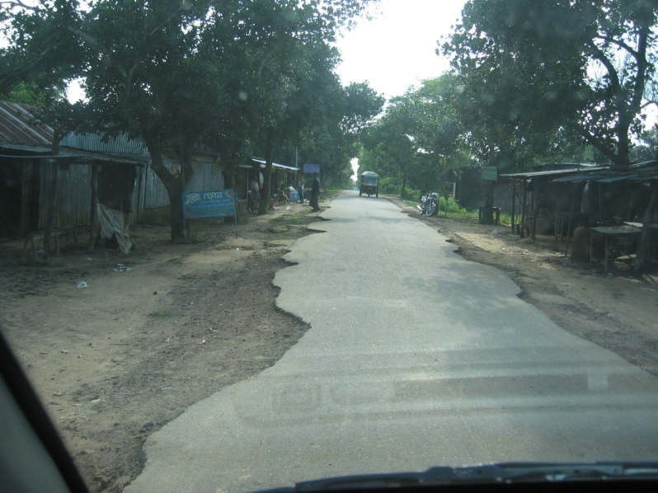
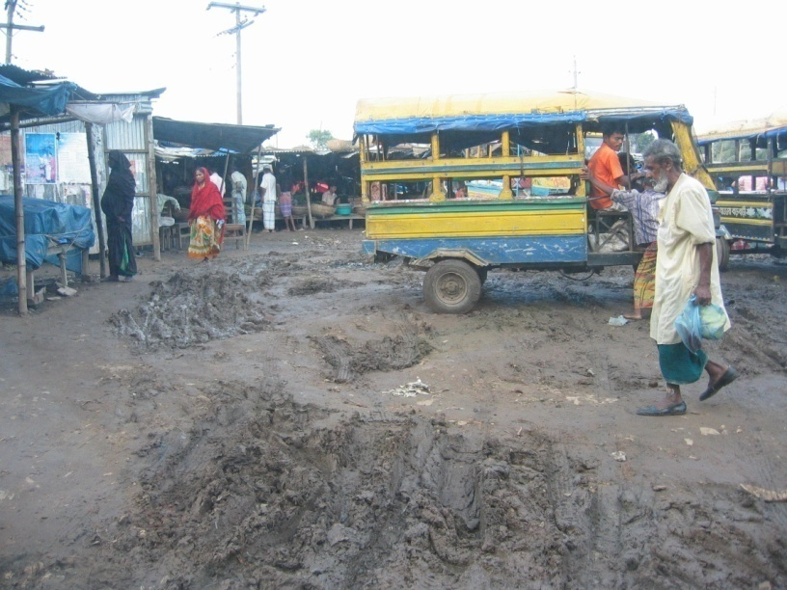
Bangladesh: Review Highlights 1
DATA
  Works history & quantities
  Loss of pavement/surfacing
  Road width & use of video
  Extreme conditions
  Special features, eg Villages, etc
WORKS STANDARDS
  Low AADT (< 100) and High AADT (> 10,000)
  Vehicle types
  Solutions in towns & villages
TOOL CALIBRATION
  Reasonable

Slide 19
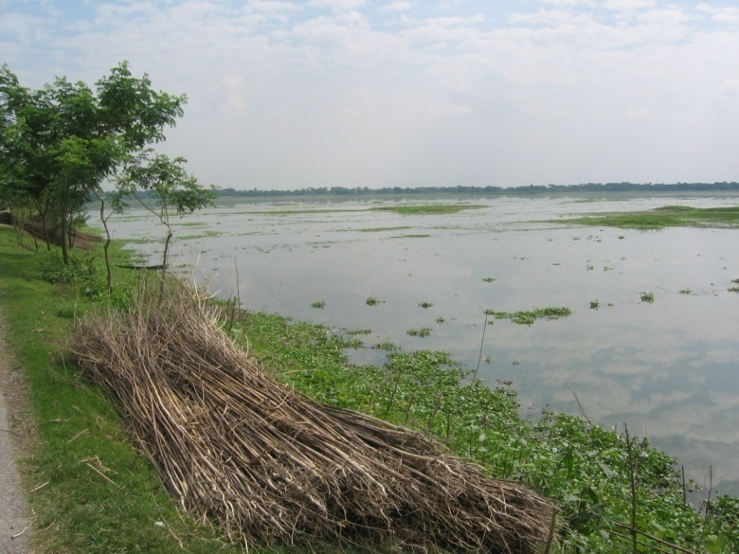
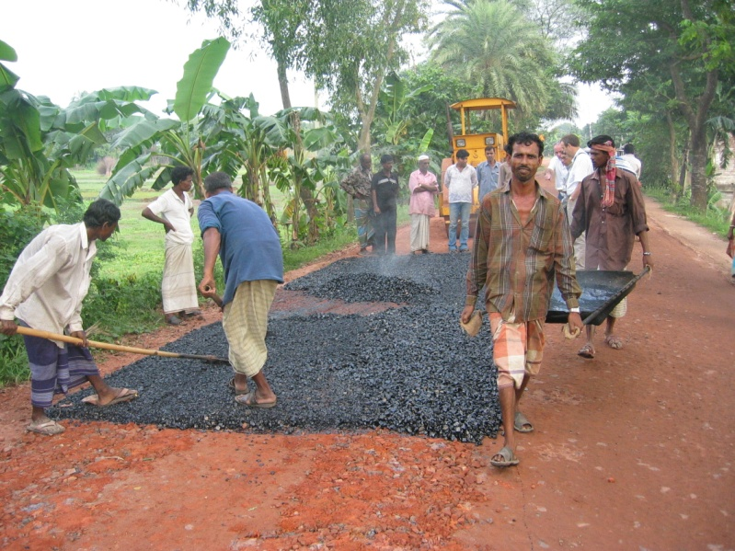
Bangladesh: Review Findings 2
STRATEGIES
  Holding treatment v optimum
  Alternative strategies relative to minimum
MAINTENANCE NORMS
  District roads dominated by floods, loss of access, etc
PRESENTATION OF RESULTS
  RAMS MAP & Executive reports
  1 year or 1 -3 year program
IMPLEMENTATION SOLUTIONS
  Urban/village problems
  Surface dressing on District Roads
  Use of emulsions
  Are Bituminous Carpets effective?
PLANNING DATA
  Flood levels & Access Constraints
  Generated/Diverted traffic

Slide 20
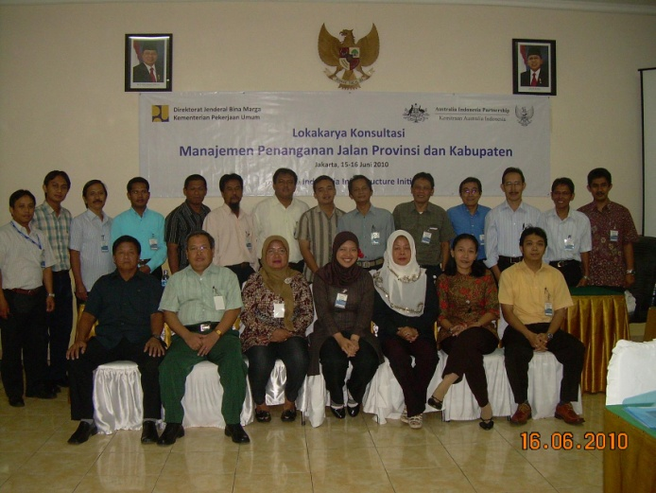
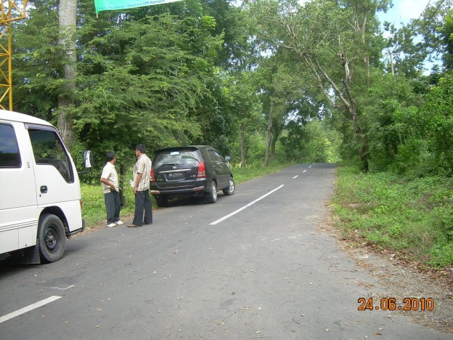
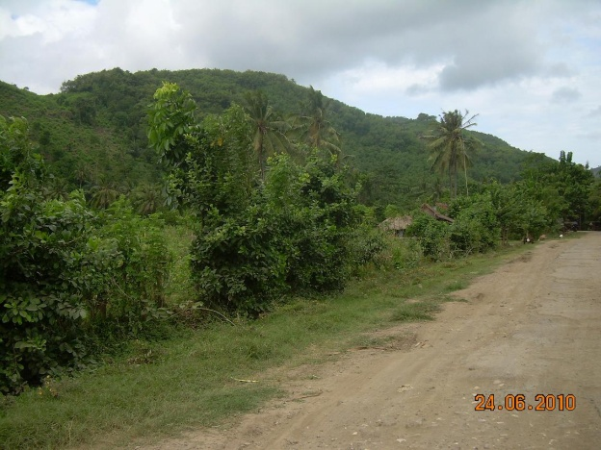
Indonesia: Maintenance capacity building
Under-resourced at provincial and district level
Reported need for improved data & greater transparency in planning
Overall need for a tool and planning process
2010-2014 focus on cross ministry and jurisdictional planning & performance management

Slide 21
Indonesia: Primary activities
Selection of review agencies
Funding needs and mechanisms, practices and capabilities
Road maintenance delivery
Procedures and tools
Legal and regulatory framework, and procurement and support

Slide 22
Network characteristics: Measures
Different surface types well represented
    sealed road proportion: 100% - 25%
    unsealed road proportion: 90% - 25%
    unpaved earth
Stable road conditions
    Provincial 95% -25%,
    Kabupaten 80% - 25%
Ratio of asset value to Gross Regional Domestic Product
Better-than-average performance
Notes:
The total length of road network represented by all sub-national agencies participating in this review (the review network) is approximately 14,920 kilometres. The 8 kabupatens participating represented approximately 6,636 kilometers, while the 5 provinces represented approximately 8,284 kilometers of network maintained.
Close to three-quarters of the networks subject to review have sealed surfacing, with most of the remainder being various paved but unsealed, or unpaved formed roads. Only 4% of the review networks have been reported as unformed or similar tracks.
Asphalt constitutes around half of the review network surfacing.

Slide 23
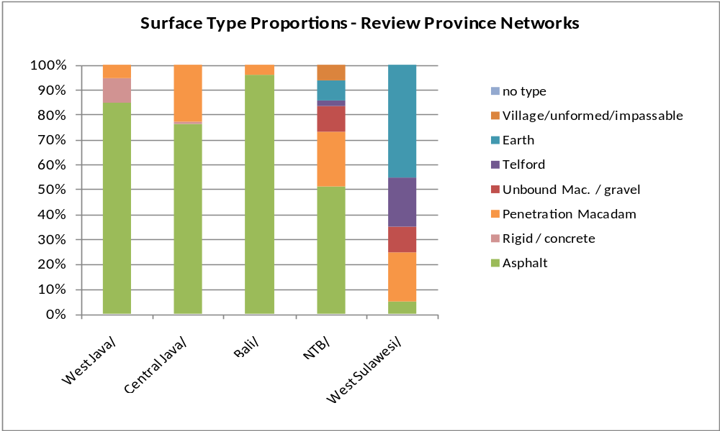
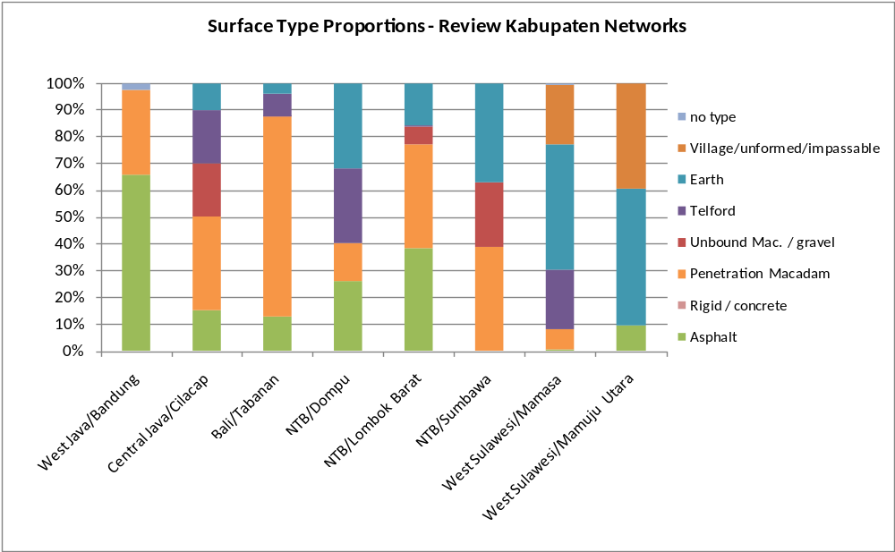
Network characteristics
Notes:
Figure 2 shows that the kabupaten networks are predominantly unsealed, the exceptions being Bandung Kabupaten (West Java), Lombok Barat Kabupaten (NTB) and Tabanan Kabupaten (Bali). However, the kabupaten networks present a wide mix of surfacing types.
Mamasa Kabupaten (West Sulawesi) presents the most undeveloped network, in terms of surfacing types, while Bandung Kabupaten (West Java) and Tabanan Kabupaten (Bali) present almost fully developed, sealed networks.
Figure 3 - Proportions of surface type for review provinces
Figure 3 shows that the provincial networks are predominantly sealed, the exception being West Sulawesi Province, which is approximately 25% sealed.
West Sulawesi therefore presents as the most undeveloped of the review networks. West Java, Central Java and Bali Provinces are essentially fully sealed networks, and would require different maintenance treatments and priorities from those needed in West Sulawesi and West Nusa Tenggara.

Slide 24
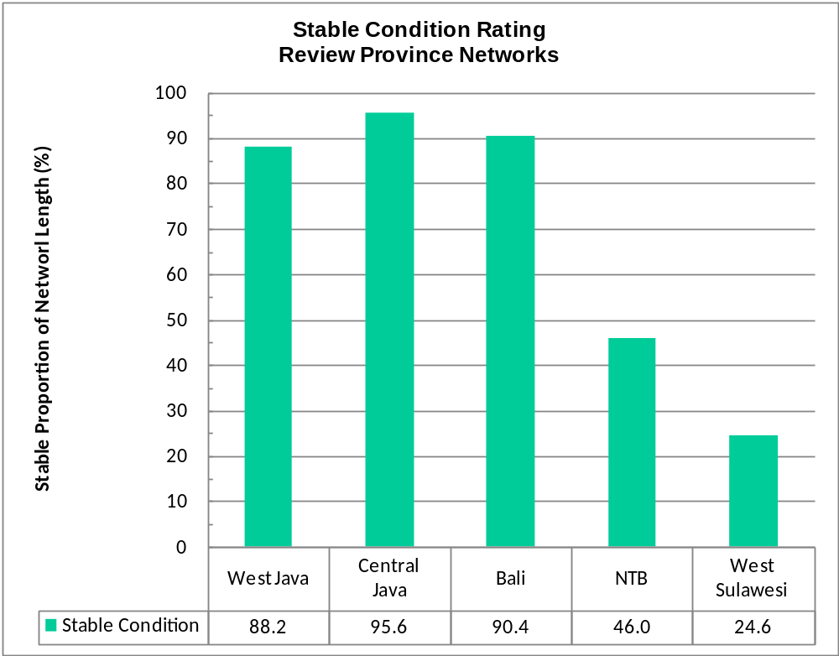
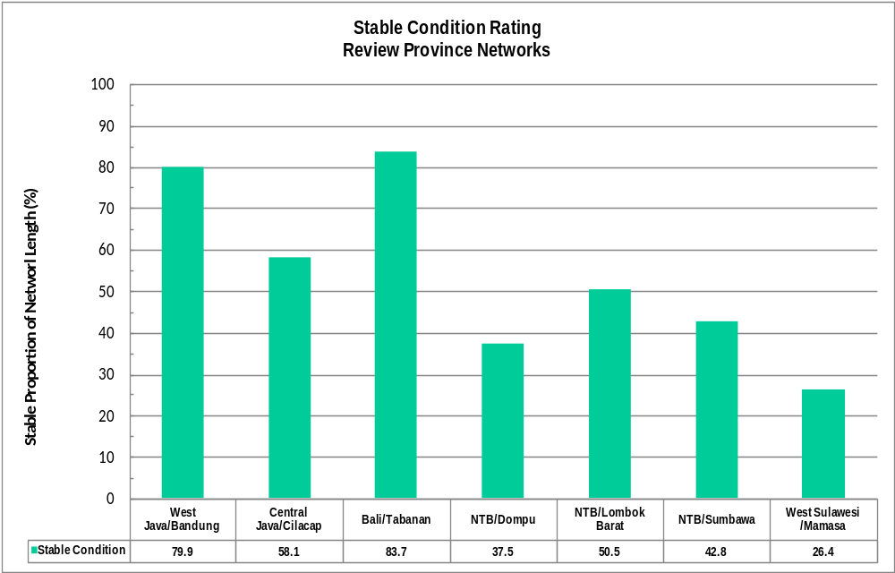
Network condition: Stable roads
Notes:
Figure 2 shows that the kabupaten networks are predominantly unsealed, the exceptions being Bandung Kabupaten (West Java), Lombok Barat Kabupaten (NTB) and Tabanan Kabupaten (Bali). However, the kabupaten networks present a wide mix of surfacing types.
Mamasa Kabupaten (West Sulawesi) presents the most undeveloped network, in terms of surfacing types, while Bandung Kabupaten (West Java) and Tabanan Kabupaten (Bali) present almost fully developed, sealed networks.
Figure 3 - Proportions of surface type for review provinces
Figure 3 shows that the provincial networks are predominantly sealed, the exception being West Sulawesi Province, which is approximately 25% sealed.
West Sulawesi therefore presents as the most undeveloped of the review networks. West Java, Central Java and Bali Provinces are essentially fully sealed networks, and would require different maintenance treatments and priorities from those needed in West Sulawesi and West Nusa Tenggara.

Slide 25
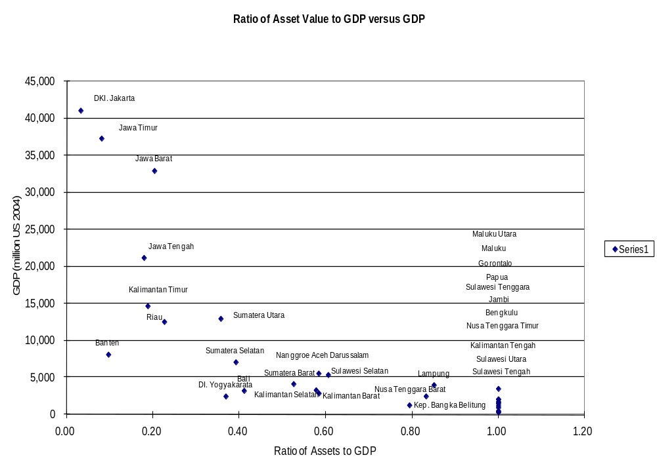
Ratio of Asset Value to GRDP

Slide 26
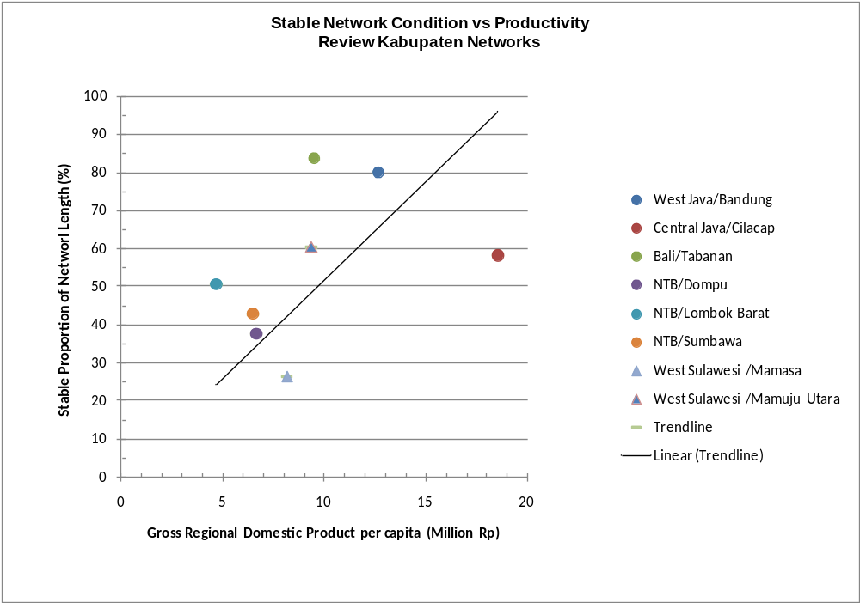
Network condition vs Productivity

Slide 27
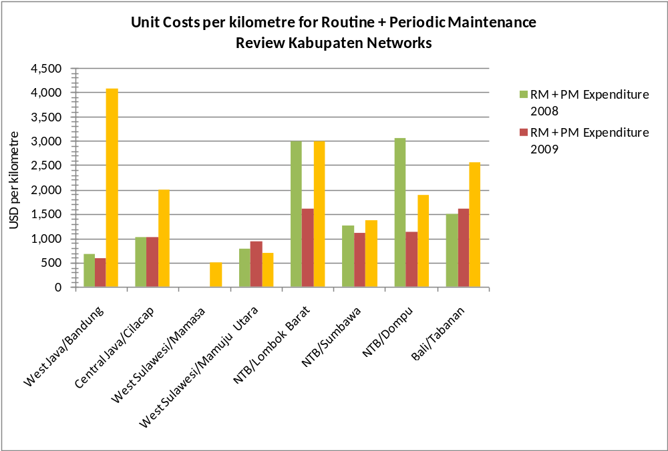
Average cost rate: Kabupaten roads
Significant variation in ‘Independent’ Average Cost Rates
Why?
Notes:
Figure 4 shows the Funding Demand/Supply ratios for review agencies. High ratio values (greater than 1) indicate that funding demand exceeds supply, implying that maintenance needs are not being fully met each year, and that a maintenance backlog exists. Ratio values less than 1 indicate that the expenditure level is higher than known maintenance needs. This can occur if unpredictable emergent expenditure is required or if expenditure budget is being inefficiently allocated.
In both years, routine maintenance funding needs of the review kabupatens are 17 to 22 times current expenditure, while in provinces the ratio is approximately 1.5 to 2.5. This confirms the general observation made by many that routine maintenance in kabupatens occurs at infrequent and insufficient levels.
Similar, but less dramatic ratio comparisons exist for periodic maintenance in kabupatens (ratios 8 to 10) and provinces (ratios 3 to 4).
For reconstruction and overlays in review provinces, it appears that actual expenditure exceeds the maintenance need, which may be an indication of allocative inefficiency.
For all maintenance activity considered together, the Funding Demand/Supply Ratios – in the range 3 to 6 – are at levels where there is some possibility that maintenance backlogs could be substantially reduced or eliminated if a disciplined and systematic medium term commitment for maintenance prioritization and management is made by the national and sub-national administrations.

Slide 28
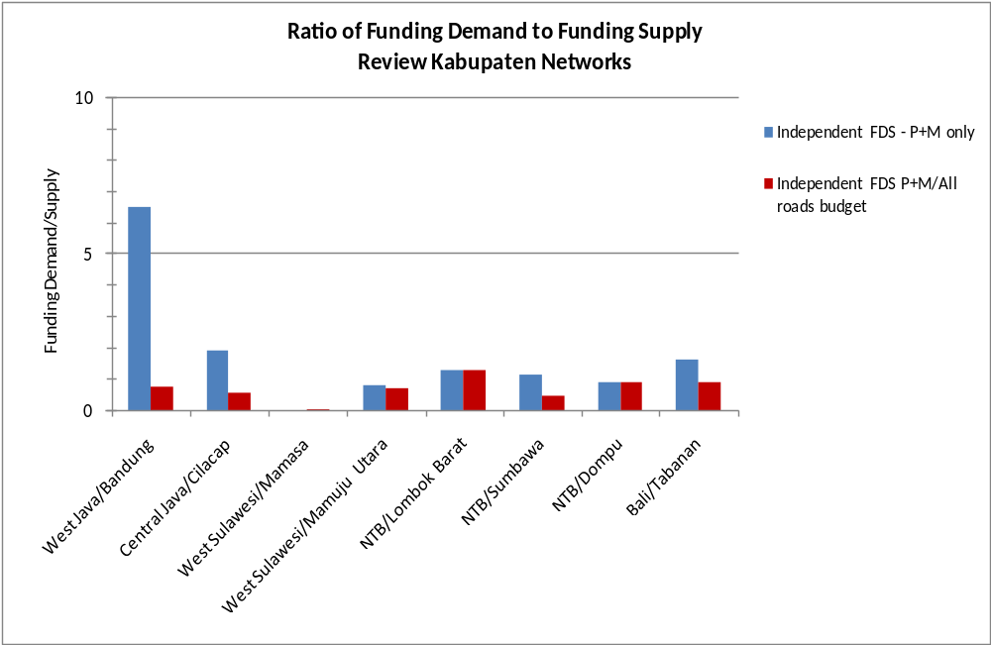
Funding demand supply: District roads
FDS for RM + PM based on Current Allocations = 1.8
FDS for RM + PM based Roads Sector Budget = 0.6
Notes:
Figure 4 shows the Funding Demand/Supply ratios for review agencies. High ratio values (greater than 1) indicate that funding demand exceeds supply, implying that maintenance needs are not being fully met each year, and that a maintenance backlog exists. Ratio values less than 1 indicate that the expenditure level is higher than known maintenance needs. This can occur if unpredictable emergent expenditure is required or if expenditure budget is being inefficiently allocated.
In both years, routine maintenance funding needs of the review kabupatens are 17 to 22 times current expenditure, while in provinces the ratio is approximately 1.5 to 2.5. This confirms the general observation made by many that routine maintenance in kabupatens occurs at infrequent and insufficient levels.
Similar, but less dramatic ratio comparisons exist for periodic maintenance in kabupatens (ratios 8 to 10) and provinces (ratios 3 to 4).
For reconstruction and overlays in review provinces, it appears that actual expenditure exceeds the maintenance need, which may be an indication of allocative inefficiency.
For all maintenance activity considered together, the Funding Demand/Supply Ratios – in the range 3 to 6 – are at levels where there is some possibility that maintenance backlogs could be substantially reduced or eliminated if a disciplined and systematic medium term commitment for maintenance prioritization and management is made by the national and sub-national administrations.

Slide 29
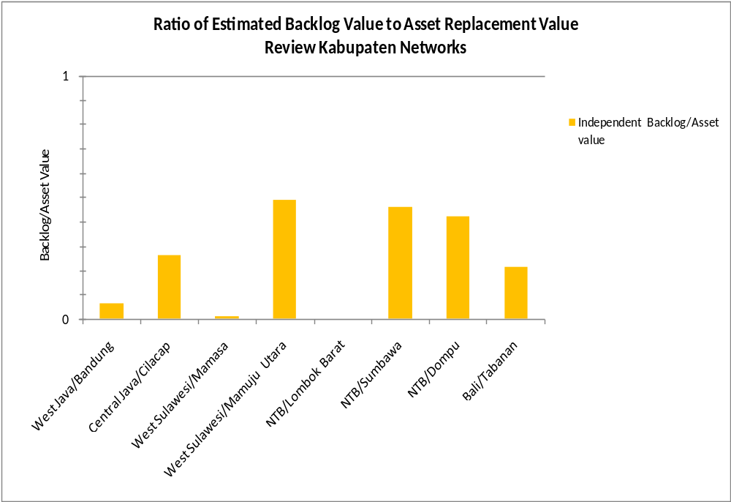
Ratio of Backlog to ARV: District roads
Backlog vs ARV
  Very variable, and mixed by location
Notes:
Figure 4 shows the Funding Demand/Supply ratios for review agencies. High ratio values (greater than 1) indicate that funding demand exceeds supply, implying that maintenance needs are not being fully met each year, and that a maintenance backlog exists. Ratio values less than 1 indicate that the expenditure level is higher than known maintenance needs. This can occur if unpredictable emergent expenditure is required or if expenditure budget is being inefficiently allocated.
In both years, routine maintenance funding needs of the review kabupatens are 17 to 22 times current expenditure, while in provinces the ratio is approximately 1.5 to 2.5. This confirms the general observation made by many that routine maintenance in kabupatens occurs at infrequent and insufficient levels.
Similar, but less dramatic ratio comparisons exist for periodic maintenance in kabupatens (ratios 8 to 10) and provinces (ratios 3 to 4).
For reconstruction and overlays in review provinces, it appears that actual expenditure exceeds the maintenance need, which may be an indication of allocative inefficiency.
For all maintenance activity considered together, the Funding Demand/Supply Ratios – in the range 3 to 6 – are at levels where there is some possibility that maintenance backlogs could be substantially reduced or eliminated if a disciplined and systematic medium term commitment for maintenance prioritization and management is made by the national and sub-national administrations.

Slide 30

Local Roads Planning Rules
Low Volume Roads
Management System
Database
Review & Update
Rapid
Surveys
Screening
Surveys
Alternative works
Modeling
Costing
Benefits
Screening &
Ranking
Yes
Traffic
& Speed
FINAL PROGRAMMING
PRELIMINARY PROGRAMMING
Motorable ?
Population &
Transport Constraint
No
Surveys
Project Identification
Local roads planning rules
LVRMS
LRPR
Notes:
We have also developed a Local Roads Management tool which is undergoing trials in Indonesia and Australia.
It includes simple data needs, treatment rules and simplified predictive models.
Decision rules can be engineering based, or include economic viability and prioritisation or social based priority ranking, e.g costs per head of population for a given road standard.
The tool is spreadsheet based and can be configured to meet local needs.

Slide 31
Indonesia: Taking modest steps in a developing context
Comprehensive and consistent advice
  DON’T DREAM – THIS IS A PARADIGM CHANGE
  Stable funding = market exists
  Priority to maintenance
  Enforceable standards
  Long term management of strategic ‘core’ network
  Foster mature behaviour
  Support industry wide capacity building
  A GRADUAL PROCESS

Slide 32
The way ahead
Establish supporting policies & regulations, and institutional aims and objectives
Sell the benefits of maintenance and renewal
Determine maintenance and investment needs
Calculate benefits and estimate outcomes as normal business
Evaluate your performance
Build a ‘Community of Practice’
Notes:
There is clearly much we can do, let’s dwell on these then conclude:
Finally, …..

