Slide 1
Low-Cost Rural Road Surfacing:
The Use of Burnt Clay Bricks
IRF / gTKP/ CHTS
2nd International Convention no Rural Roads
@
Jinan, Shandong Province, China
Edmund Kwasi Debrah
CSIR-Building & Road Research Institute
P.O. Box UP 40, KNUST
Kumasi, Ghana.

Slide 2
Presentation Structure
Background
The Case at CSIR-BRRI
    Introduction
    The Pavement Design
    The Basic Materials
    The Construction Process
    Post-Construction Performance
    Economic Appraisal of the Project
Conclusion
Recommendation

Slide 3
Background
Rural Access Promotes Socio-Economic Development
High Cost of Gravel Surface Rural Roads
Sustainability Problems
  Investment without maintenance Capabilities
                Johnston and Slater (2001)
Basic Conditions for Gravel Roads not Met
  Availability of Suitable Material
  Shorter Haulage Distances [less than 10km]
  Rainfall [less than 2000mm/year]
  Dry Season Dust Generation
  Road Terrain [Gradients less than 6%]
  Reliable Financing and Resource
                Petts (2008)

Slide 4
Background
Alternative Surfacing Options
  Proven Successful in many Countries
  Use of Available materials
  Utilizes Small Enterprises + Local Labour
  Lower Maintenance Requirements
Burnt Clay Brick Road Surfacing Appropriateness
  Abundance of Clay [Ghana: 1350M Tonnes] Bediako (2009)
  Production of Bricks Meet ASTM- C902-99 Specification
    Ghana : Boadi and Obeng (2003)
    Nigeria : Okunanade (2008)
  CSIR-BRRI Burnt Brick Surfaced Road

Slide 5

The BPR at the CSIR-BRRI: Brief
In 2002: Brick Paved Road @ CSIR-BRRI
250m in total length
3 Types of Bricks
All brick types meet ASTM No. C902-99 Specs.
Av. Traffic: 150 vpd (light traffic)
Subjected to Environmental Elements
No Maintenance Interventions Since Construction

Slide 6

The Pavement Design
In-situ material CBR- 30%
Design Life – 10 years
Projected Daily Traffic ≤ 200 veh [100 ESALs]
h = 42.12mm, Adopt 50mm
4%
Concrete
Curb
Interlocking Burnt Clay Bricks
Fine Aggregate Blinding- 12mm
Hand Compacted Gravel Material- 50mm
Subgrade
Concrete Footing

Slide 7
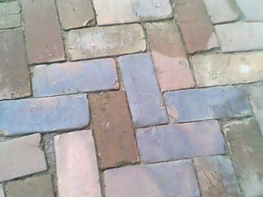
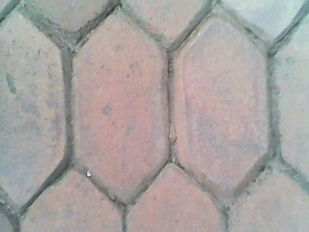
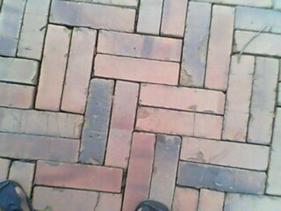
The Basic Materials Used
Sample | Av. Firing Temp (⁰C) | Physical Characteristics |  |  | Engineering Properties
 |  | Shape | Dimensions (mm) |  | Compressive Strength (N/mm²) | Water Absorption (%)
Type I | 950 | Rectangular | 9 x 21x 7 |  | 19.24 | 15.84
Type II | 950 | Hexagonal | 6 x 12 x 7 |  | 18.28 | 15.93
Type III | 1050 | Rectangular | 9 x 20 x 7 |  | 21.80 | 9.26
Source: Boadi and Obeng, 2003
Plate 1a: Type I
Plate 1b: Type II
Plate 1c: Type II

Slide 8
The Construction Process
Grading of Existing Ground to Required Shape
Placement of :
      Pre-fabricated Concrete Curbs at sides
      50mm thick Gravel Material: Hand + Ped. Roller Compacted
      Fine Agg. - Ordinary River Sand (Blinding, 12mm thick)
Hand Laying of Burnt Clay Bricks
Filling of Irregular spaces (using Cement Mortar)
Filling in the Brick Joints (using thin layer of fine sand)

Slide 9
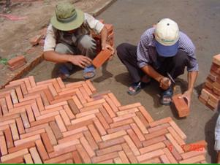
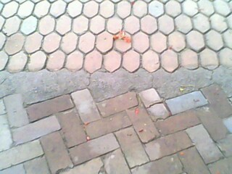
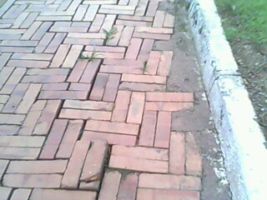
The Construction Process
Figure 1. Cross Section around the Concrete Curb
Plate 2a
Plate 2b
Plate 2c

Slide 10
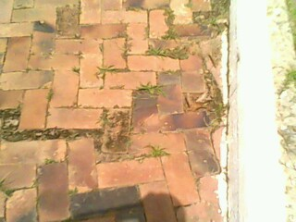
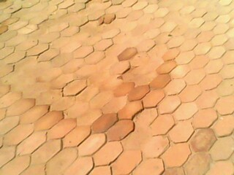
Post - Construction Performance
Few sections show some distress
No Maintenance Interventions Since Construction
No Total Road Surface Failure (after 8 yrs)
Surface Distresses vary depending on the type
High Abrasion Resistance results from higher temperatures, in excess of 1050: Al-Amaireh (2009)
Plate 3a: Type I
Plate 3b: Type II
Plate 3c: Type III

Slide 11
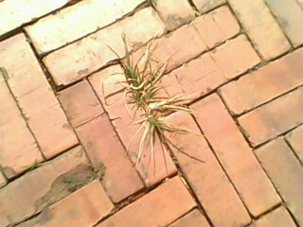
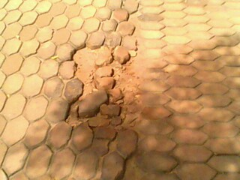
Post - Construction Performance
Accelerated Deterioration after Construction are as a result of:
  The absence of Damp Proof Course (DPC)
  Irregular sections without Filling Mortar
Plate 4a
Plate 4b

Slide 12
Economic Appraisal of the Project
Discount Rate – 12%
Table 1. Summary Results of the Economic Analysis
Economic Indicator | Brick Surfaced Road |  | Gravel Road
IRR B/C Ratio | 26.3% 3.2 |  | 15.9% 2.4

Slide 13
Conclusion
Burnt Clay Bricks:
  satisfy the ASTM No. C902-99 Specifications
  are appropriate for surfacing light trafficked road.
Rural Friendly Construction Techniques
Minimal Maintenance
Greater Economic Benefits

Slide 14
Recommendation
Replication projects be carried out on areas with light traffic especially rural accesses.
The construction technique employed should be intermediate type.(Usage of appropriate hand tools and light equipment.)
Labour should come from the local residents from the beneficiary communities.
Adopting proven strategies for the construction and maintenance of rural roads ensures an all-year round trafficability: Jukka Isotalo(1992)
Prior to the construction, it is important to engage all stakeholders including opinion leaders of the beneficiary communities.
Further research be conducted in the improvement of the production of burnt clay bricks that have better engineering properties.

