Slide 1
A HIGHLY AMBITIOUS RURAL ROAD IMPROVEMENT PROGRAM DELIVERED UNSUCCESSFULLY-A CASE STUDY OF SRI LANKA
By
Granie R Jayalath
Faculty of Graduate Studies,
University of Colombo, Sri Lanka

Slide 2
CONTENTS
A brief note of the geo-graphic location of sub grade
Status of Rural Transport Governance
New” Rural Roads” improvement initiative
Lessons learned and suggestions for improvement
The way forward

Slide 3
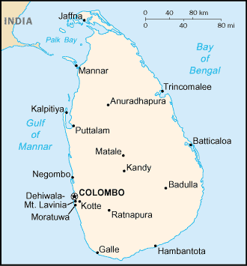

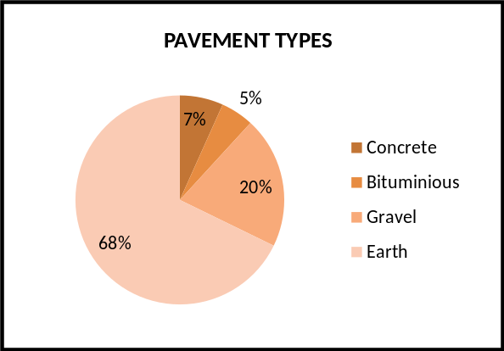
Geo-Graphic Location
The Road Network
Class | Total Length (Km)
National Roads Class A and B | 11,716
Provincial Roads Class C and D | 15,532
Rural Road Network E class and unclassified | 64,659
TOTAL | 91,907
Composition of pavement types

Slide 4
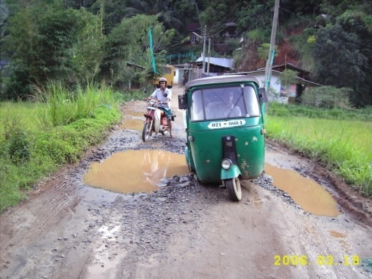
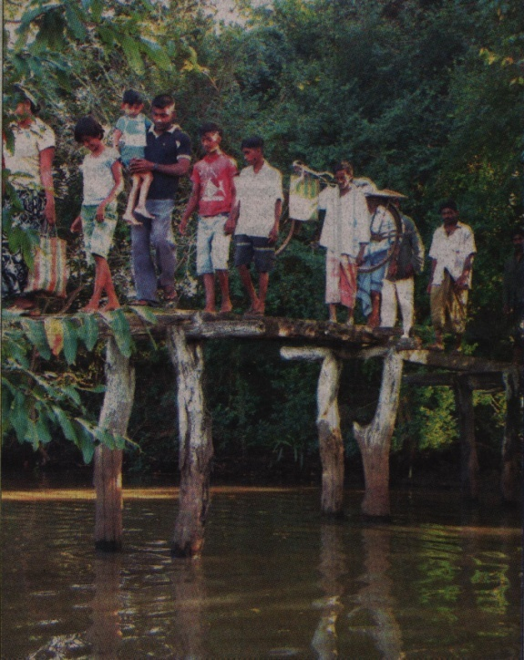
Status of Rural Transport Provision- Socio-economic Status
Province | Number of villages with no access to a road network | Number of villages with partial Access to a road network
Northern province | Not available | Not available
Eastern province | 98 | 195
North central | 52 | 43
North western | 53 | 64
Central Province | 116 | 202
Sabaragamuwa | 153 | 198
Sothern Province | 114 | 178
Uva Province | 167 | 314
Western Province | 16 | 37
Total | 769 | 1231
More than 800 villages completely isolated
1231 villages have difficult accessibility to a road
There are inhabitants still need to walk 10-12km distance to in search of basic facilities
Each year ……….rural schools get closed

Slide 5
Status of Rural Transport Governance- Organizational Structure
Parliament - President
9 Provincial Councils
270 local authorities- responsible for the country’s rural road infrastructure
Each PS division has approximately 290km of rural roads
Ministry of Public Administration & Home affairs
Ministry of Local Government & Provincial Councils
District Administration (District Secretariat Network)
Provincial council Network & Commissioner of Local Government & Provincial Councils
Divisional Administration (Divisional Secretariat Network)
Pradeshiya Saba Network -270
Village level Administration ((Grama Niladari Network)
Village Level Community based Organizations
Development & Maintenance of rural road network
Provincial Council Account (Annually)
Decentralized capital Budget-Via members of Parliament
Locally generated funds by PS-(property tax, business tax)
Pradeshiya Saba
Funding Sources
Other sources- NGO and INGO

Slide 6
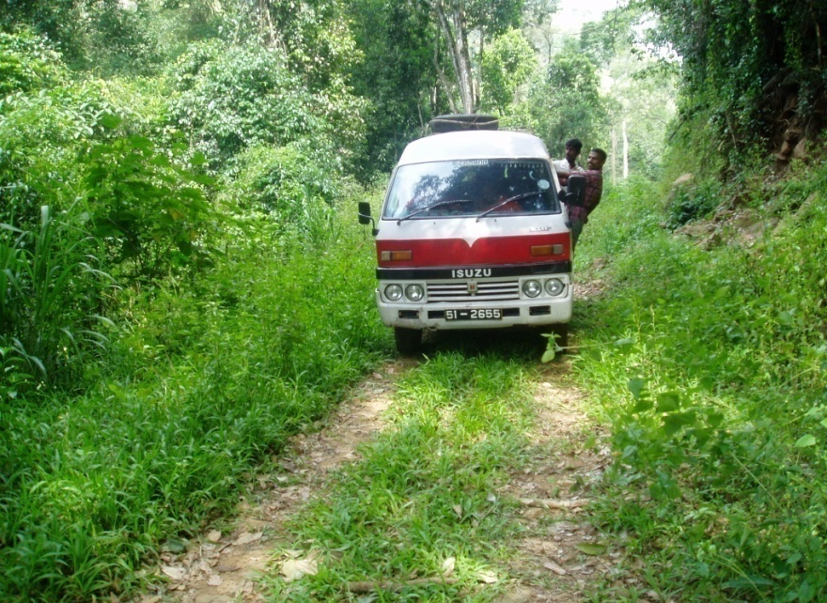
Status of Rural Transport Governance…..cont
There is a severe deficiency in respect of human and capital resources, within local authorities
Due to lethargic management and administrative cultures local authorities grossly abrogate their responsibilities over rural mobility users.
When ever local authorities could influence on matters related improvement and construction on a constructive way such initiatives eventually end up with endorsing back the conventional approaches already in practice particularly when officials and contractors are politically influenced
The practicing prioritizing approaches for rural road development works are ad-hoc
Decision making practices are not rationally evolved, but based on trail and error.

Slide 7
New Rural Road Improvement Initiative…………….
In Y 2004 government decided to implement the rural road concreting program as a measure to over come, burden of ever deteriorating status of rural road infrastructures
A separate unit called “ Maganaguma” was established under the Ministry of Highways for this purpose. Because of urgency very little planning was done, in respect of selection criteria, design and specification, quality controlling and implementation strategies.
Hence like the default practice the new initiative too, moved forward based on trail and error concept.

Slide 8
New Rural Road Improvement Initiative…………...
Carefully formulated guidelines , method statements, were not able to provide in advance particularly on following aspects:
Design and specification
  Non-reinforcement, t=150mm
  28 days crushing strength ≥ 30N/mm2
  Construction joints @ 50m intervals
  Expansion joints @ 30m intervals
  Compulsory curing for a period of 7days
2. Selection criteria and implementation strategy
  The road should link either a national road (A & B) or a provincial road (C & D)
  The road should provide access to at least 2-3 villages
  The road should provide direct access at least to 100 road side dwellings
  The road should leads to industrial and agricultural areas
  Roads that lead to socio-economically sensitive centers such as schools, medical centers, markets etc, should give priority.
  Roads that lead to existing housing schemes or schemes likely to be constructed in near future should give priority.
  Eventually the road once improved should improve the socio-economic status of the rural community.

Slide 9
New Rural Road Improvement Initiative…………….
3. Quality Controlling
Nothing specified during construction

Slide 10
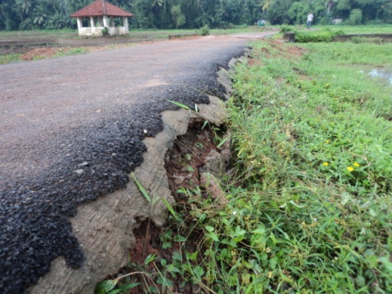
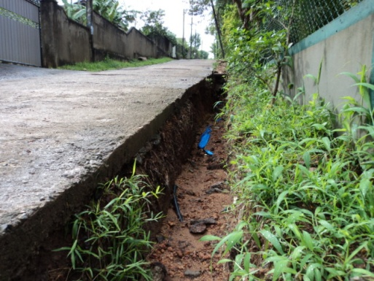
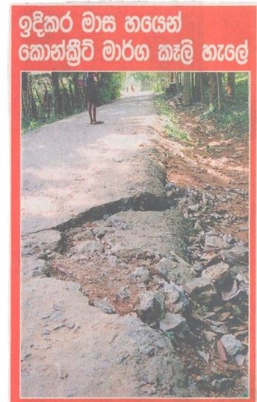
New Rural Road Improvement Initiative………
Gradually deficiencies due to poor quality concrete pavement, poor workmanships got emerged with increasing public complains
The program which reached its heights output in Y 2006 started declining and was STOPPED in Y 2010

Slide 11
New Rural Road Improvement Initiative….cont
Payments and defect liability period
  Mandatory requirement to recommend a payment was a submission of a proof to say that cube crushing strength of ≥ 30N/mm2, but following important aspects were not looked in to:
    Thickness of pavement
    Cross section camber, longitudinal grade and super-elevation
    In case existing sub-grade is excavated , density checks not done
    No information over curing process
    Whether side drainage has been looked in to
    Status of construction and expansion joints
A defect liability period of three months has been originally defined, with a retention payment of 10%------- both the period and amount are not sufficient

Slide 12
New Rural Road Improvement Program..cont
Lessons learned and suggestions for improvements
The development scenarios currently in practice for the improvement of accessibility are not rational and none of them are not taking any interest because they have to depend on central government initiatives.
The most important aspect at the first place is to understand that we need a SHIFT of our development philosophy in respect of rural mobility provision.
PROVISION OF ACCESSIBILITY
PROVISION OF MOBILITY INTERVENTIONS
Provision of accessibility is only an element of the whole rural mobility system
For example: We need to assess which alternative will yield out the maximum socio-economic returns? Either by providing concrete pavements for each and every door step or by maintaining a gravel road with a mini-bus to facilitate transport.

Slide 13
New Rural Road Improvement Program-
Suggestions for Improvement
The rural mobility provision needs a system’s approach, sustainable and affordable solutions will always be an integration of all system elements.
Transport USERS
OPTIMUM rural transport solutions
Transport REGULATORS
Transport OPERATORS
Issues & Problems encountered
Design & Specification
  No concern over surface & sub-surface drainage
Proposal Selection and Procurement strategy
  Public criticism over the actual selection criteria adopted
  Gradual dropping out of competitive tendering practice

Slide 14
New Rural Road Improvement initiative..cont
Quality Controlling
  During Construction
    Sub grade Irregularities not attended effectively, hence 150mm thickness not maintained through out
    Random & ad hoc placing of construction joints
    Excessive Slump
    No 28 days cube crushing tests were done
    No edge shoulder was constructed
  After the construction is over
    Curing not done, even by users, except frontage portions of few enthusiastic road side dwellers
    No 28 days cube crushing tests, only re-bound hammer tests and core sample testing , one test per 100m section
    Jutting out of coarse aggregates –resulting rapid wearing
    No lateral stability , safe maneuvering of vehicles
    Structural failures due to the shallow thicknesses
Payments
  10% retention not enough
  Defect liability period 3 months not adequate- now increased to 6 months – still not sufficient
Notes:
d

Slide 15
New Rural Road Improvement initiative-
Suggestions for Improvements
To mitigate /minimize the problems conventionally get emerged with types of development initiatives in developing countries , the author proposes the concept of “ SELF ASSURED STANDARDS & QUALITY” pavements
Example: Pavement Options
Example 1: As a pavement option “Metal ling and Tarring” has more on site quality steps to be followed, whereas spreading a ‘layer of hot asphalt concrete” has minimal on site quality steps.
Example 2: A “self Assured Quality” pavement design would be lying of factory casted interlocking cement sand blocks
Example: Construction Methodology
Example: For concrete pavement construction the OPTION B involves disturbances to the existing base/sub-grade whereas OPTION A doesn’t disturb the base/sub-grade

Slide 16
New Rural Road Improvement initiative..cont
Min-0.6m
3.0m
OPTION-A
OPTION-B
Encouraging “VIRTUAL MOBILITY” initiatives for urban sector will help to direct more funds for RURAL SECTOR.

Slide 17
New Rural Road Improvement initiative..cont
I am in the process of formulating an integrated decision support system for the provision of RURAL MOBILITY INTERVENTIONS
I need your help particularly those of here from Asian Continent, to collect few bits of information of their current practices, and status of governance.
I appreciate if you could fill out the simple questionnaire and pass it over to me before we say good by to the 2nd Rural Road convention, the questionnaire is the last page of my paper.

Slide 18
THANK YOU FOR YOUR PARTICIPATION

